Slide 1
Nanotube Simulation Results
26/8/2020
Kate Trinkaus

Slide 2
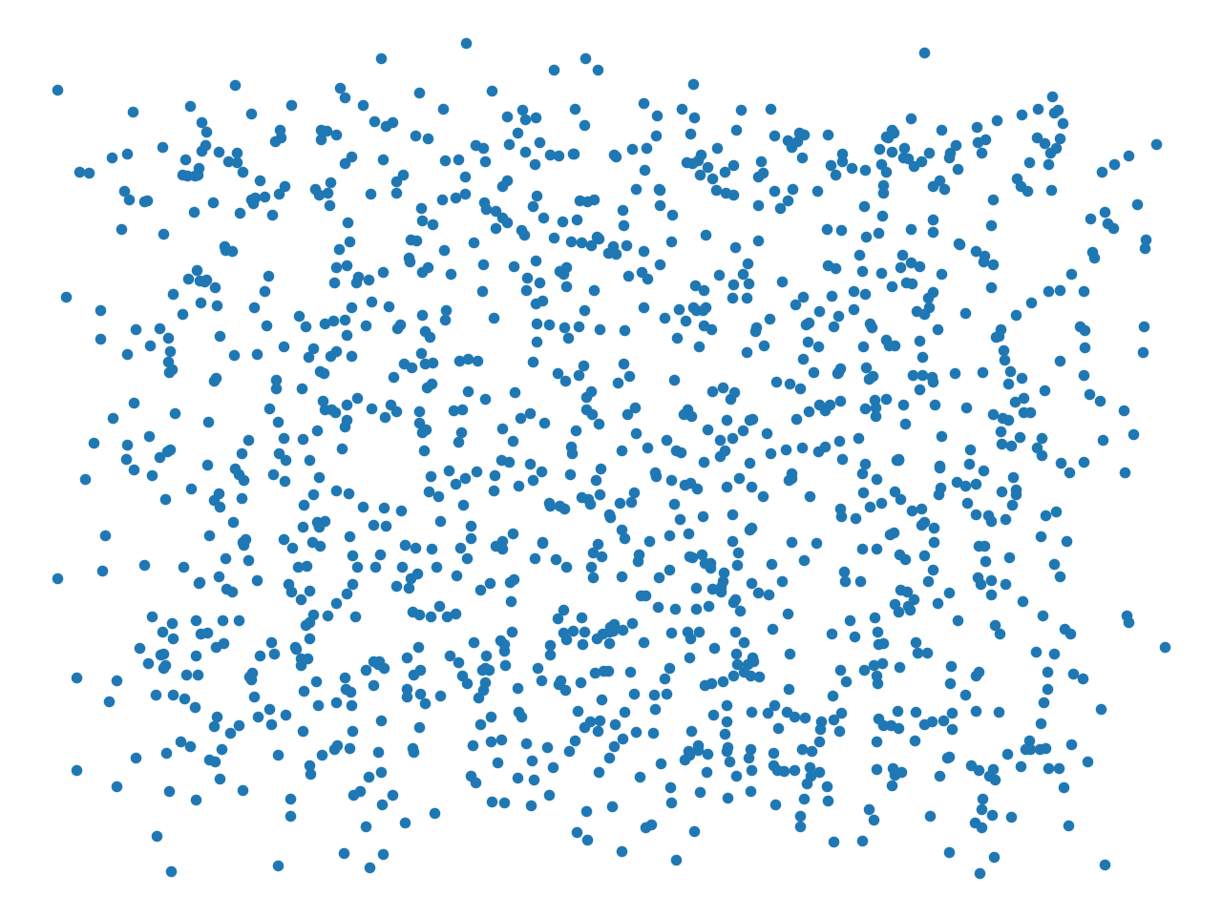
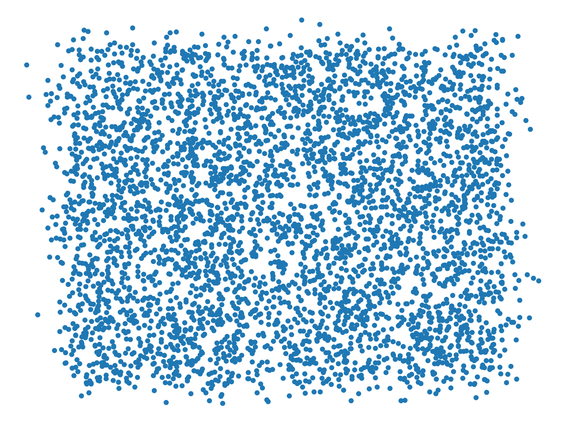
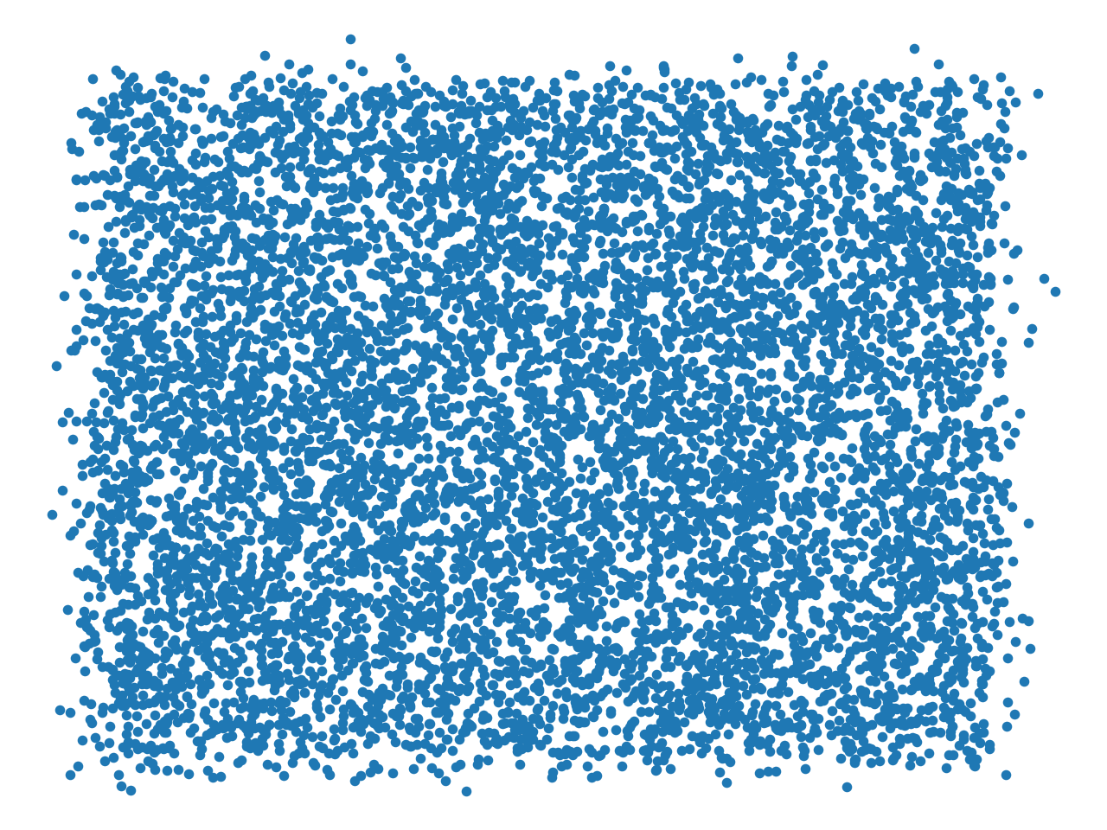
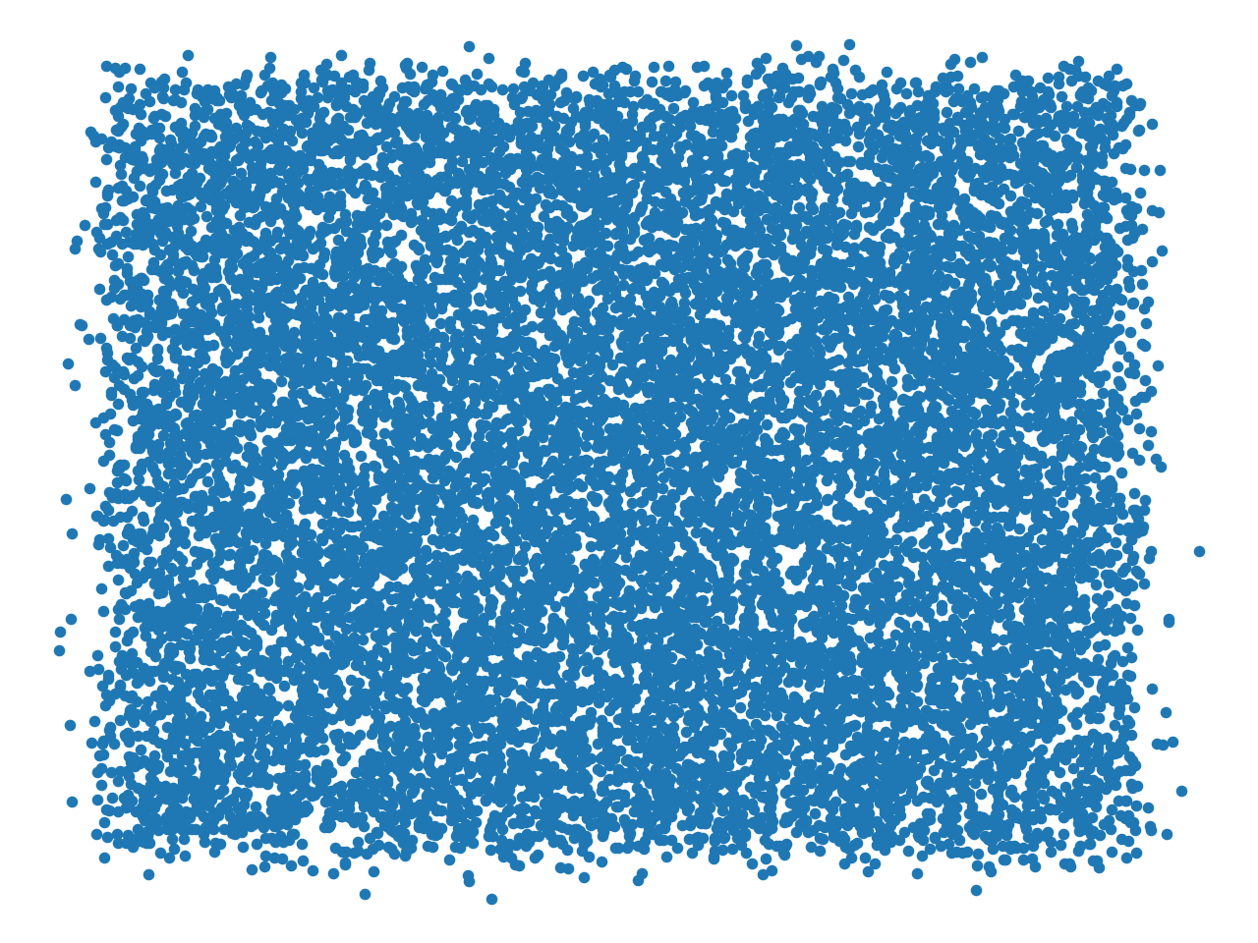


Junction Map
Vary Box Length – 3 to 13 um (2 um steps)
Same wire density: 19.6932 wires/um²
3 5 7
9 11 13
N.B. plots not to relative scale! Python automatically plotted all graphs to same scale :(

Slide 3
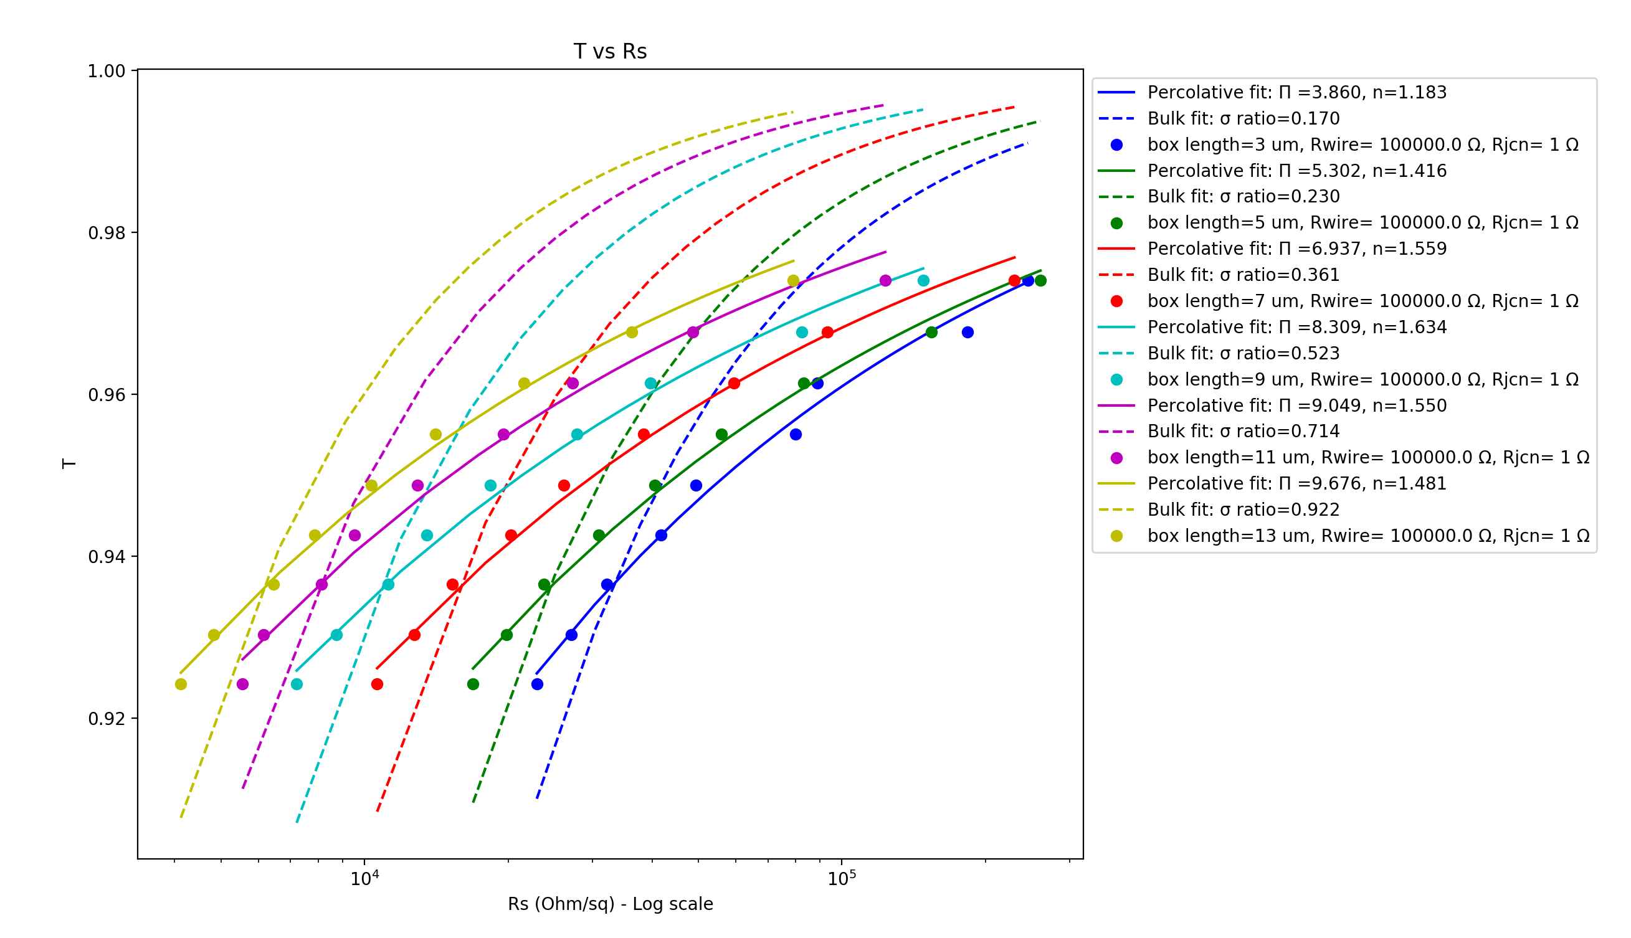
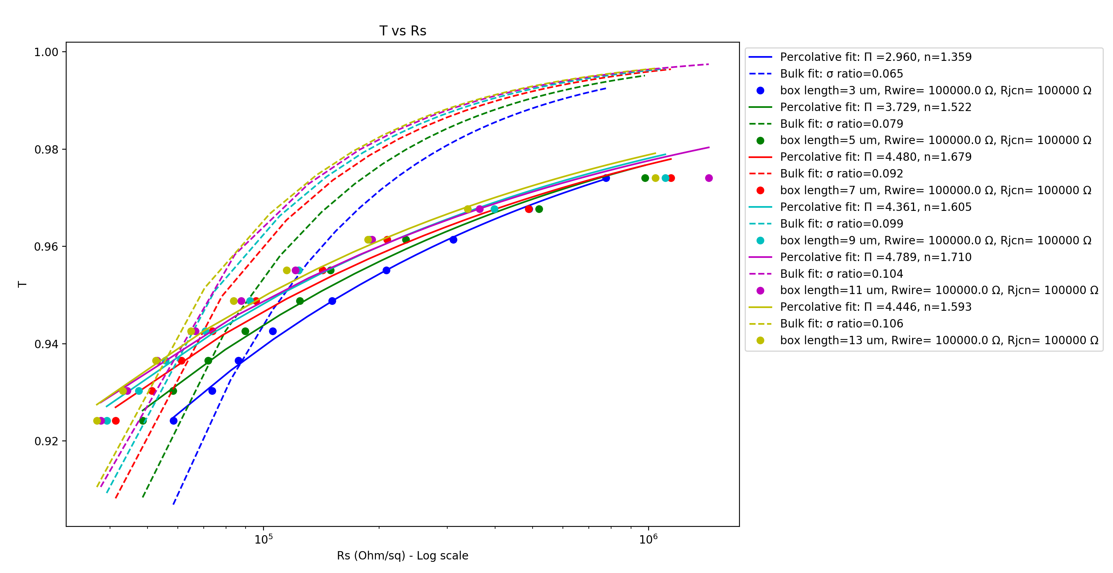
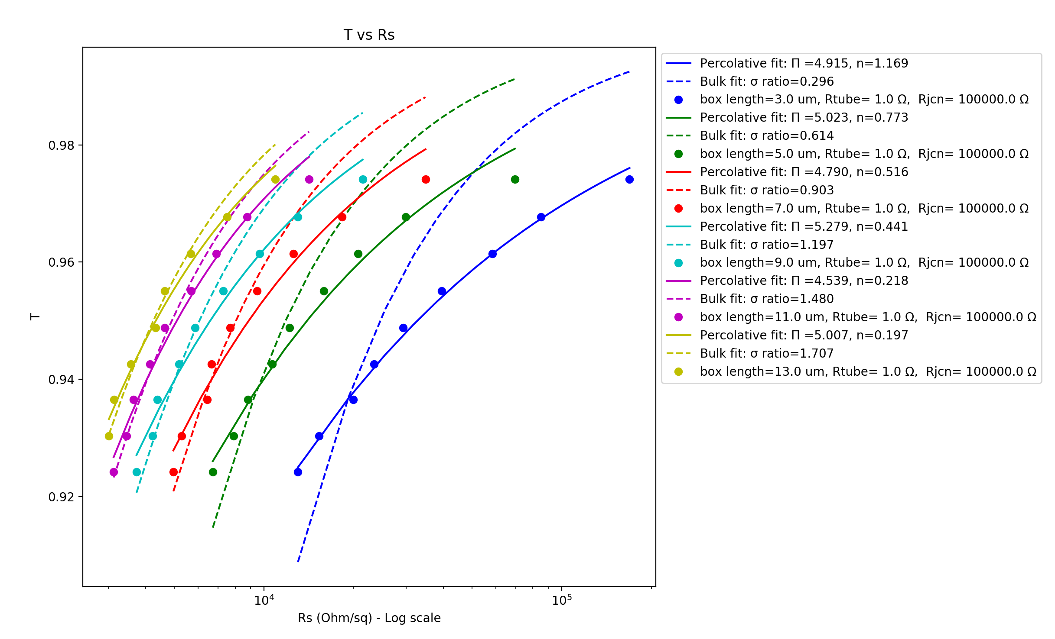
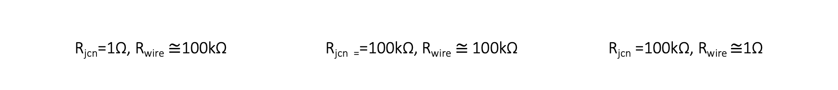
R_{jcn}=1Ω, R_{wire} $≅$100kΩ R_{jcn =}=100kΩ, R_{wire} $≅$100kΩ R_{jcn} =100kΩ, R_{wire} $≅$1Ω
Vary Box Length – 3 to 13 um (2 um steps)
Wire diameter: 1nm, Wire length: 1um, Samples: 15, 𝜌₀ constant, uniform wire length,
network density: 6.5644 to 19.6932 in 1.6411 wires/um² steps

Slide 4
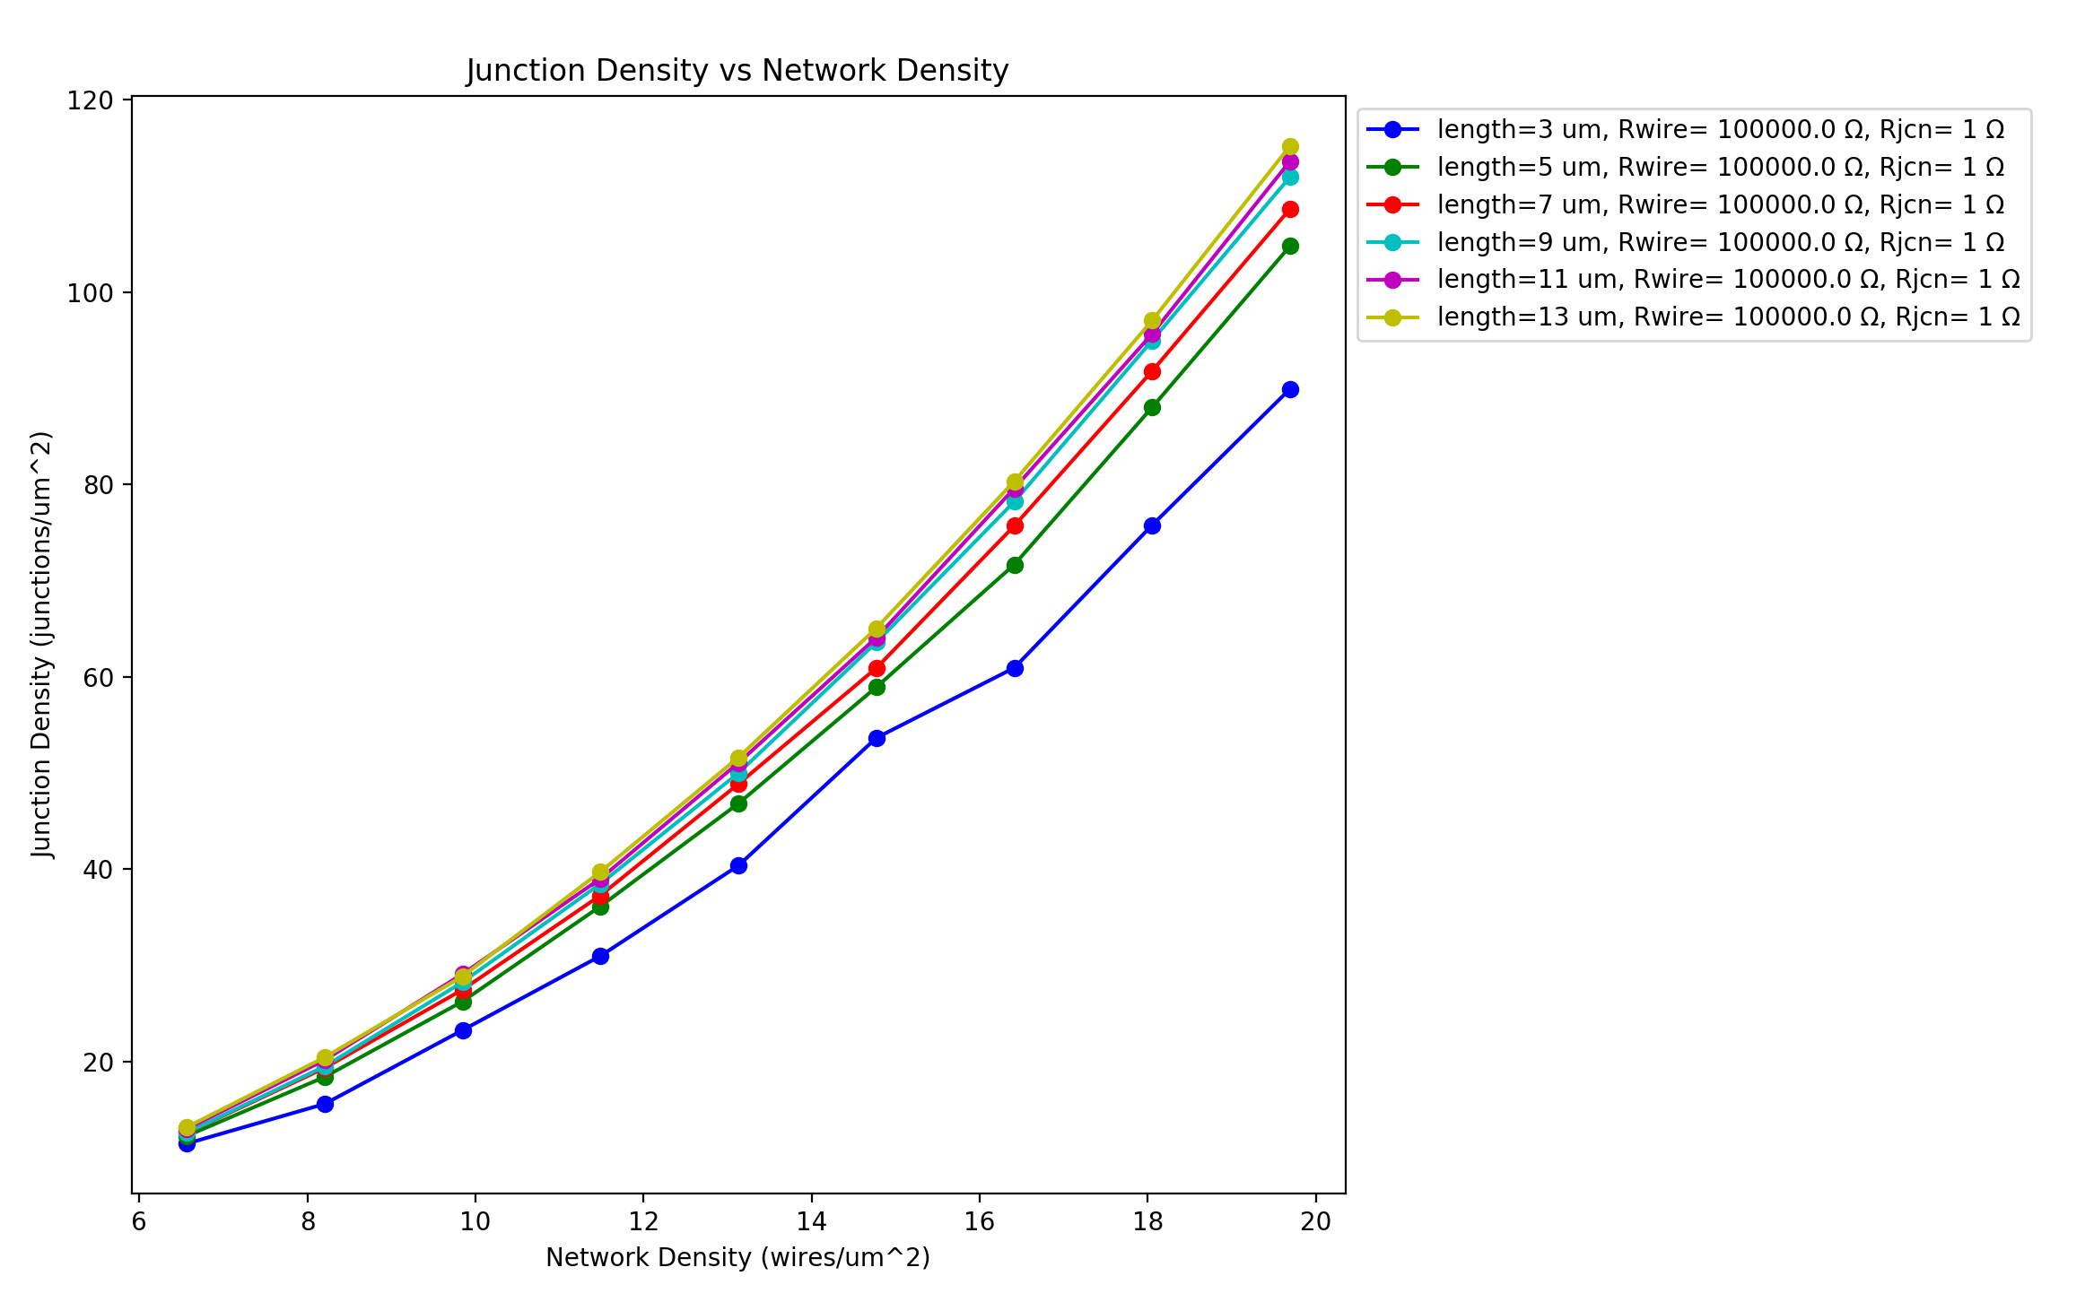
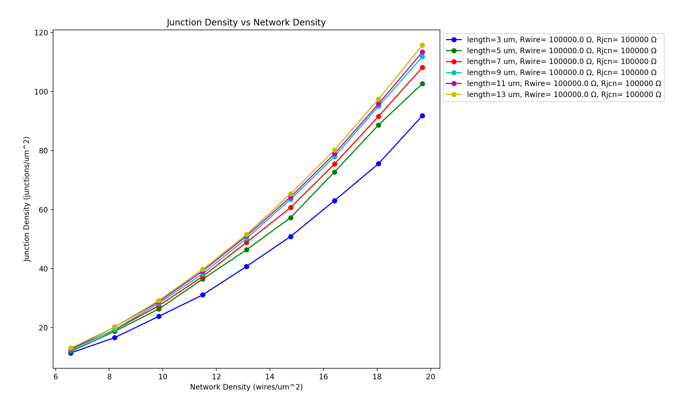
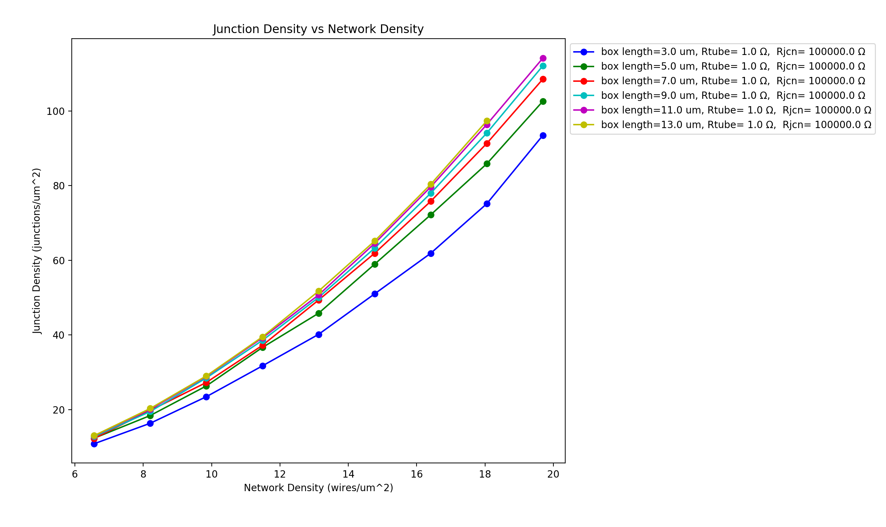
R_{jcn}=1Ω, R_{wire} $≅$100kΩ R_{jcn =}=100kΩ, R_{wire} $≅$100kΩ R_{jcn} =100kΩ, R_{wire} $≅$1Ω
Vary Box Length – 3 to 13 um (2 um steps)
Wire diameter: 1nm, Wire length: 1um, Samples: 15, 𝜌₀ constant, uniform wire length,
network density: 6.5644 to 19.6932 in 1.6411 wires/um² steps

Slide 5
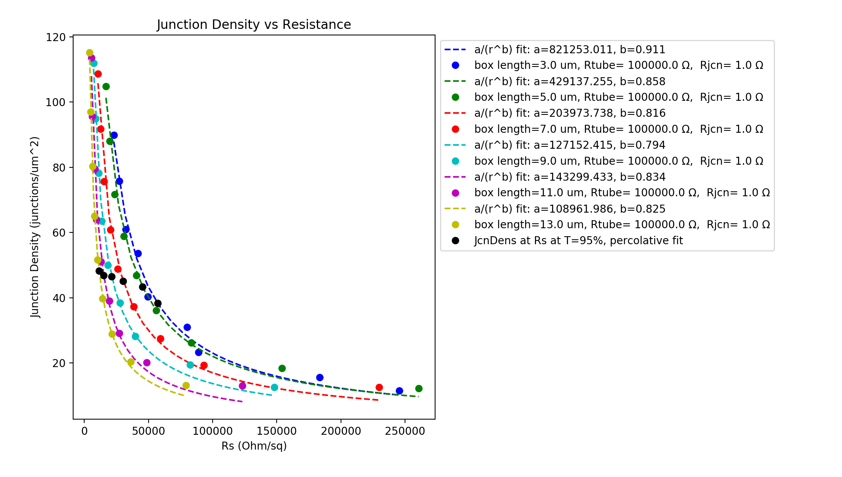
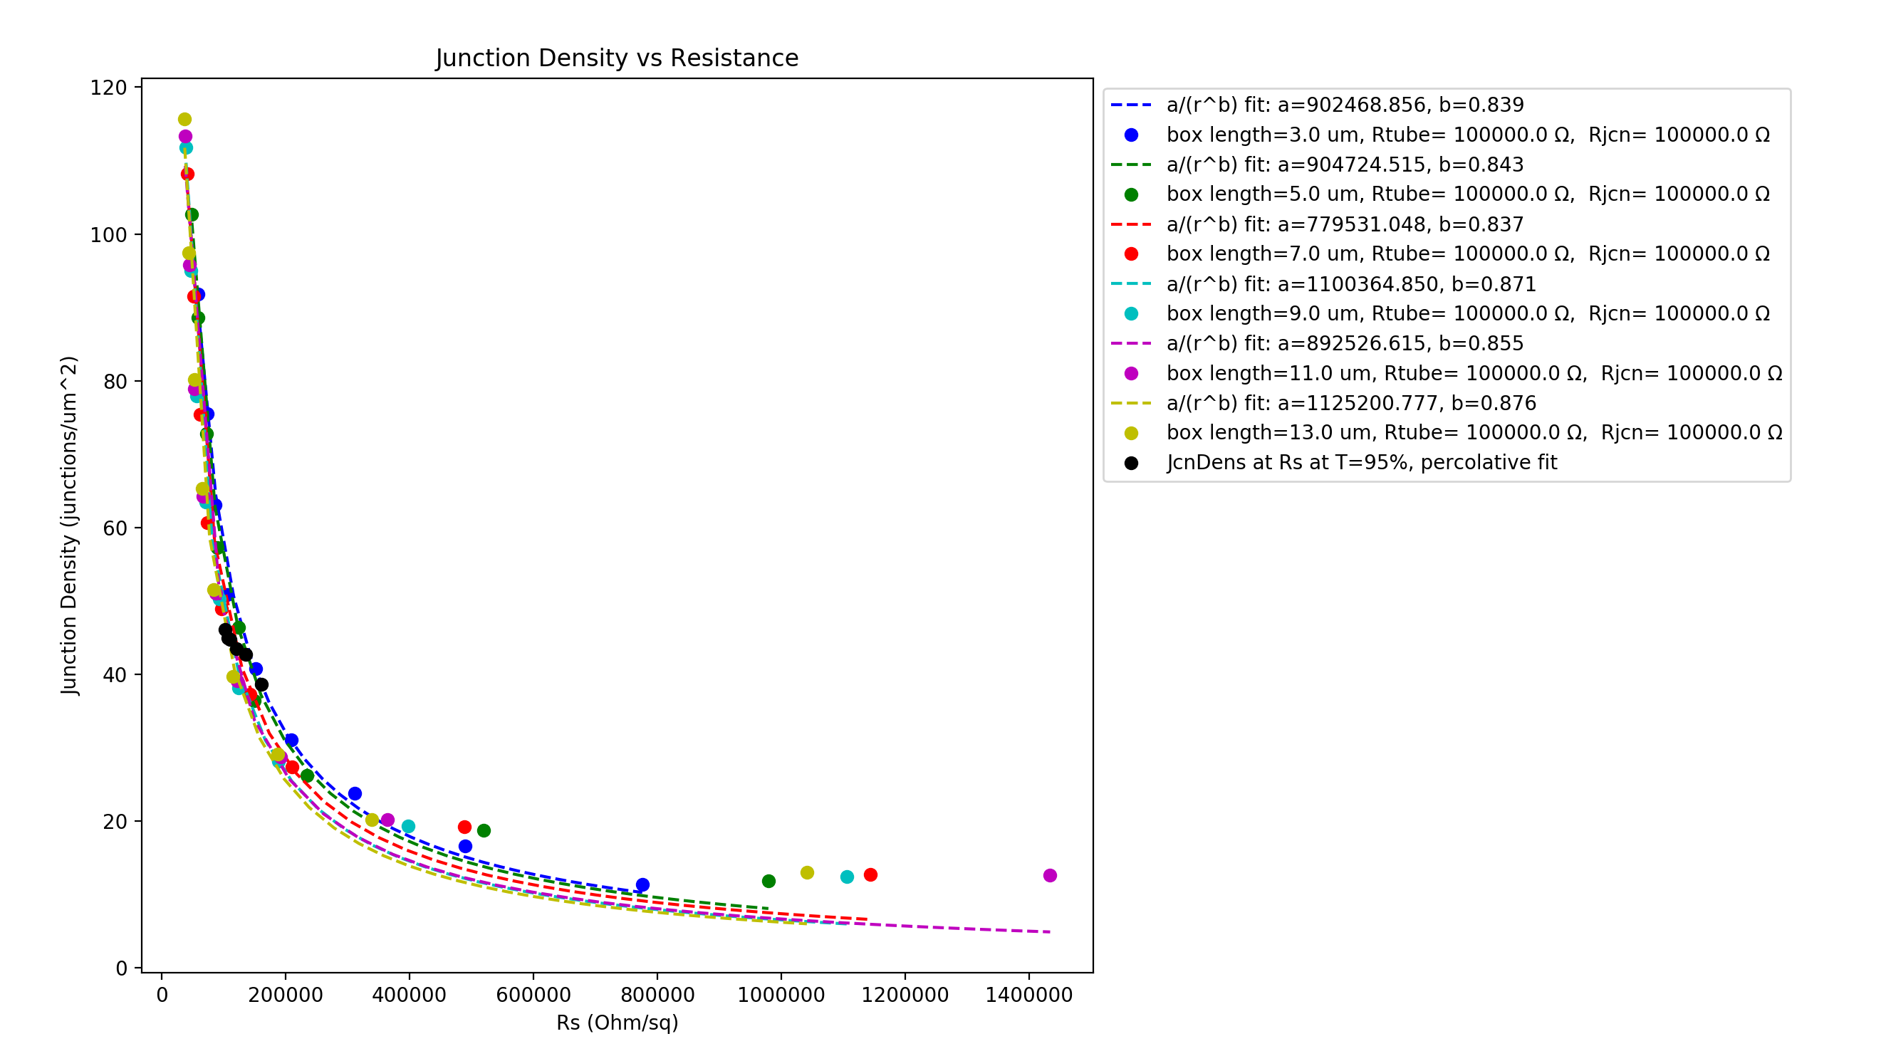
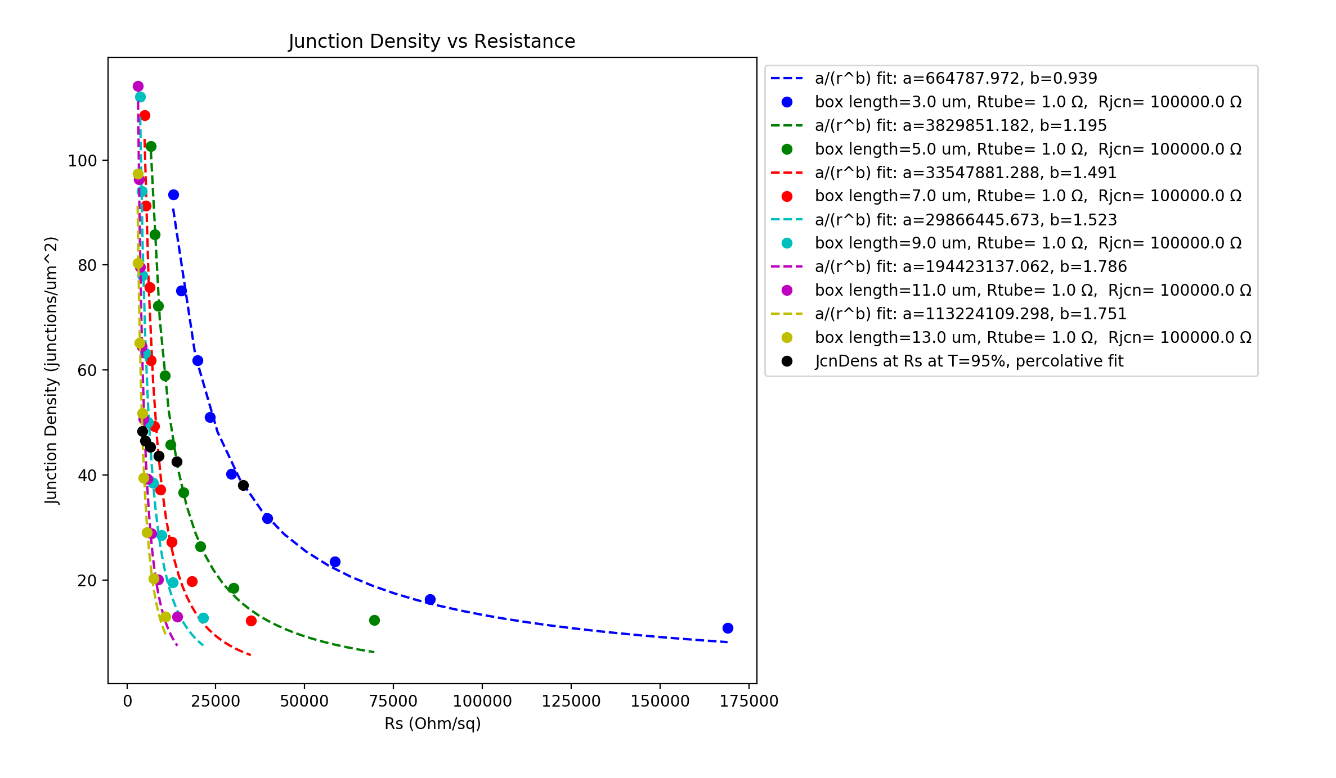
R_{jcn}=1Ω, R_{wire} $≅$100kΩ R_{jcn =}=100kΩ, R_{wire} $≅$100kΩ R_{jcn} =100kΩ, R_{wire} $≅$1Ω
Vary Box Length - 3 to 13 um (2um steps)
Wire diameter: 1nm, Wire length: 1um, Samples: 15, 𝜌₀ constant, uniform wire length,
network density: 6.5644 to 19.6932 in 1.6411 wires/um² steps

Slide 6
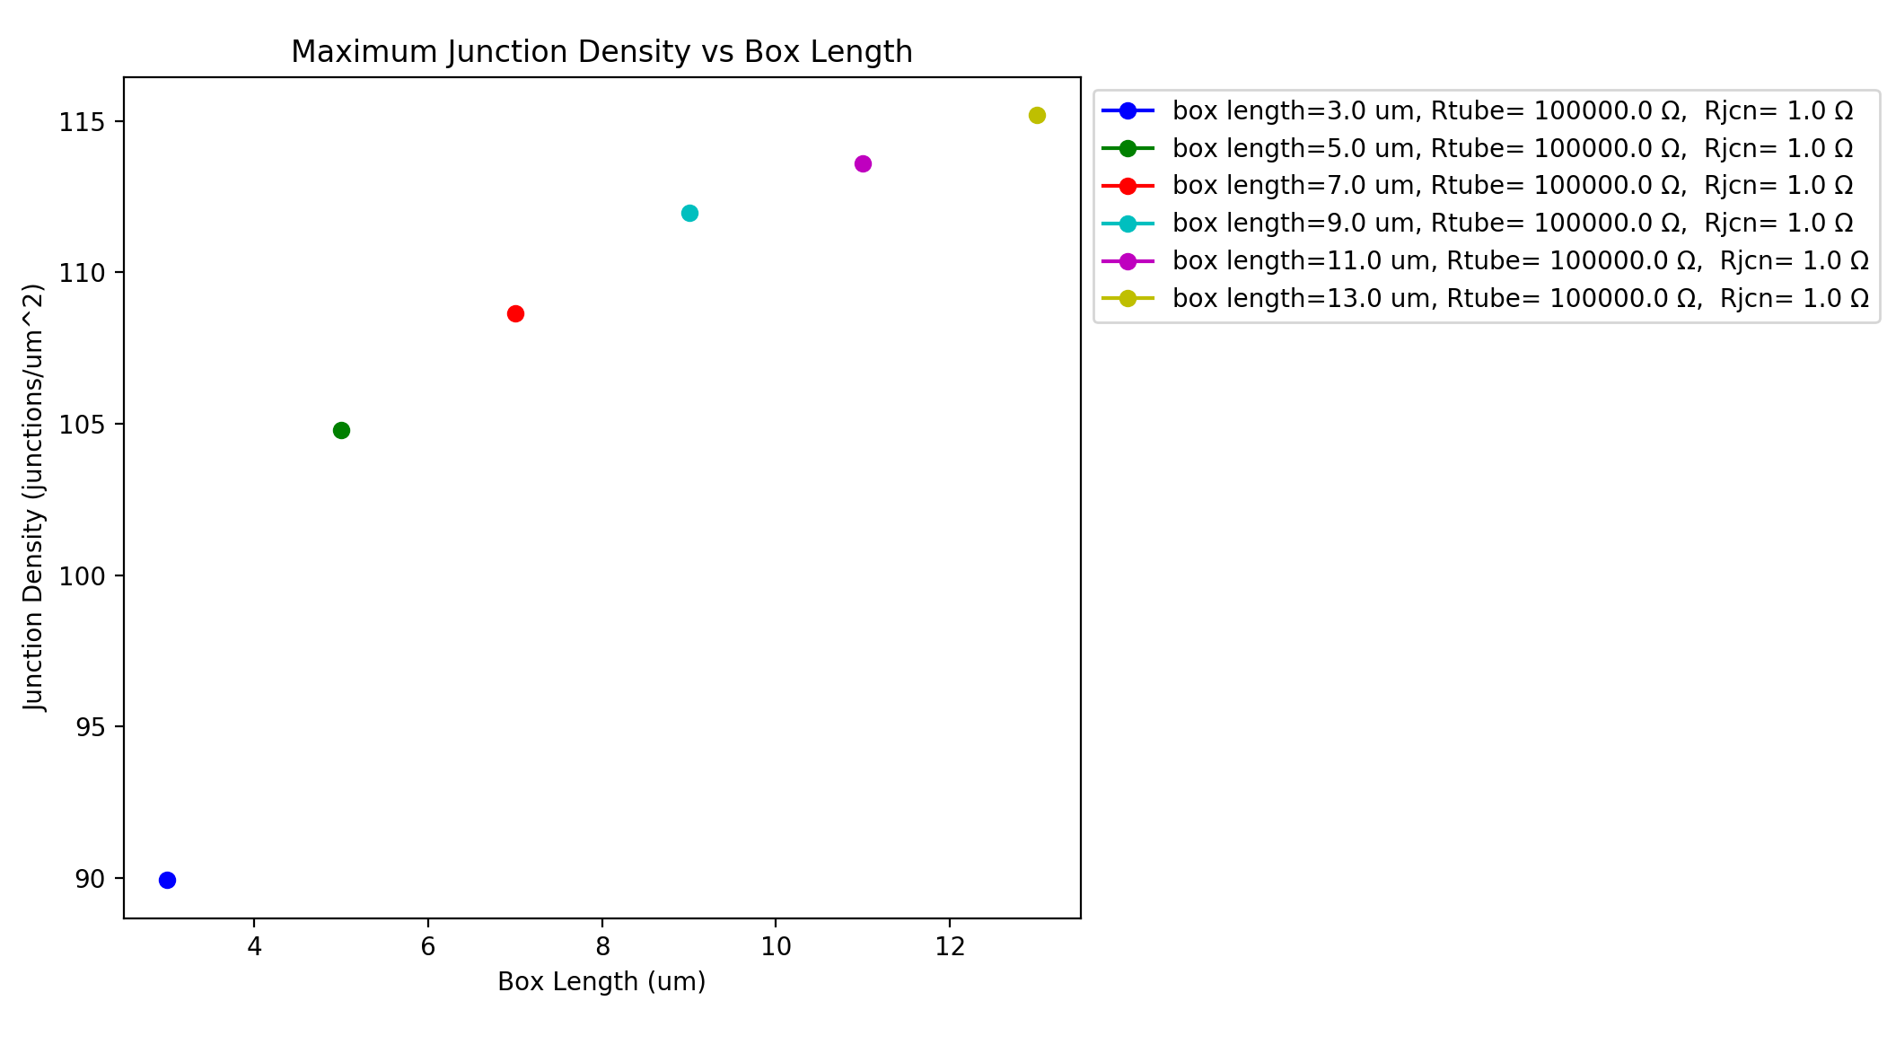
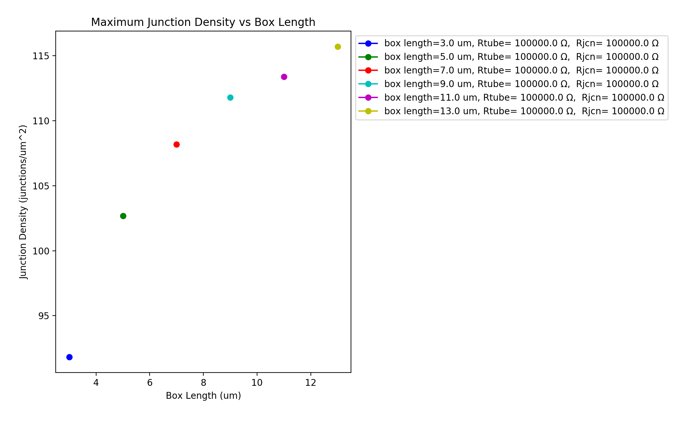
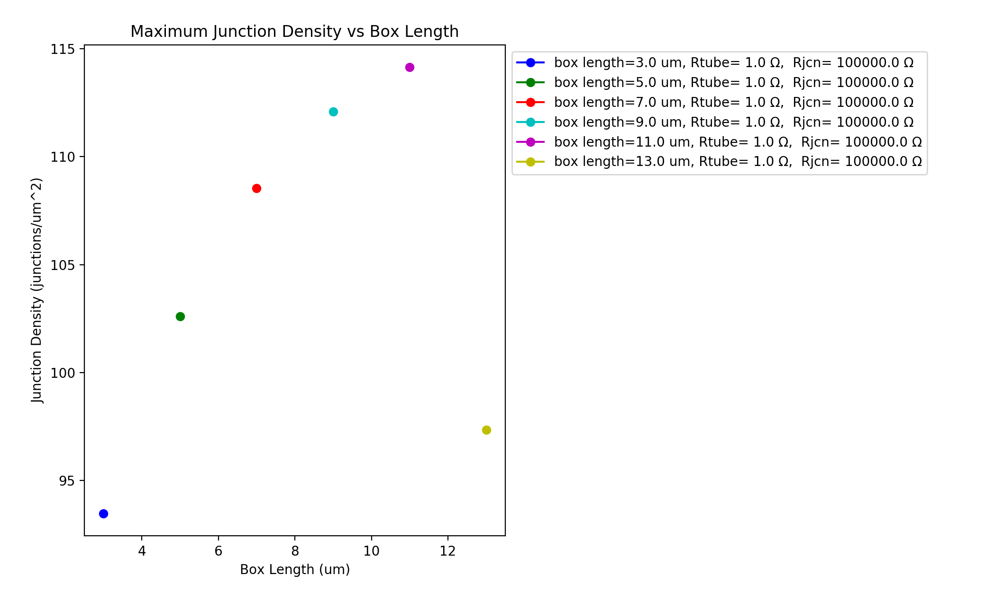
R_{jcn}=1Ω, R_{wire} $≅$100kΩ R_{jcn =}=100kΩ, R_{wire} $≅$100kΩ R_{jcn} =100kΩ, R_{wire} $≅$1Ω
Vary Box Length - 3 to 13 um (2um steps) - same network density
Wire diameter: 1nm, Wire length: 1um, Samples: 15, 𝜌₀ constant, uniform wire length,
network density: 6.5644 to 19.6932 in 1.6411 wires/um² steps

Slide 7
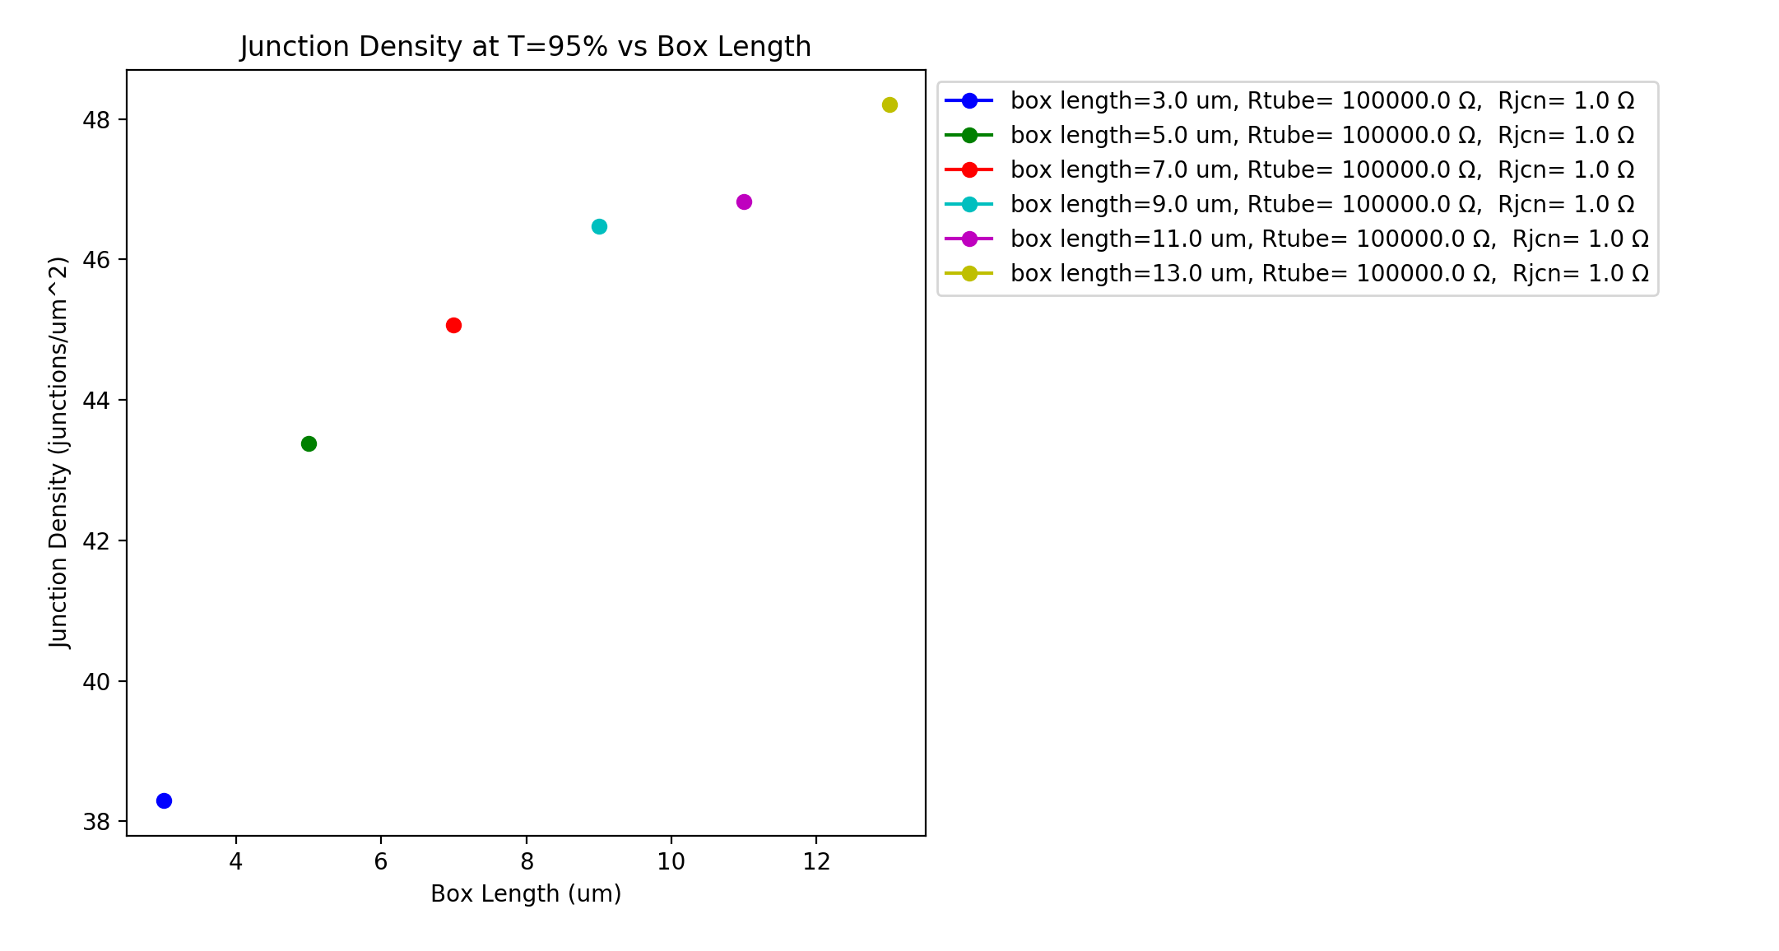
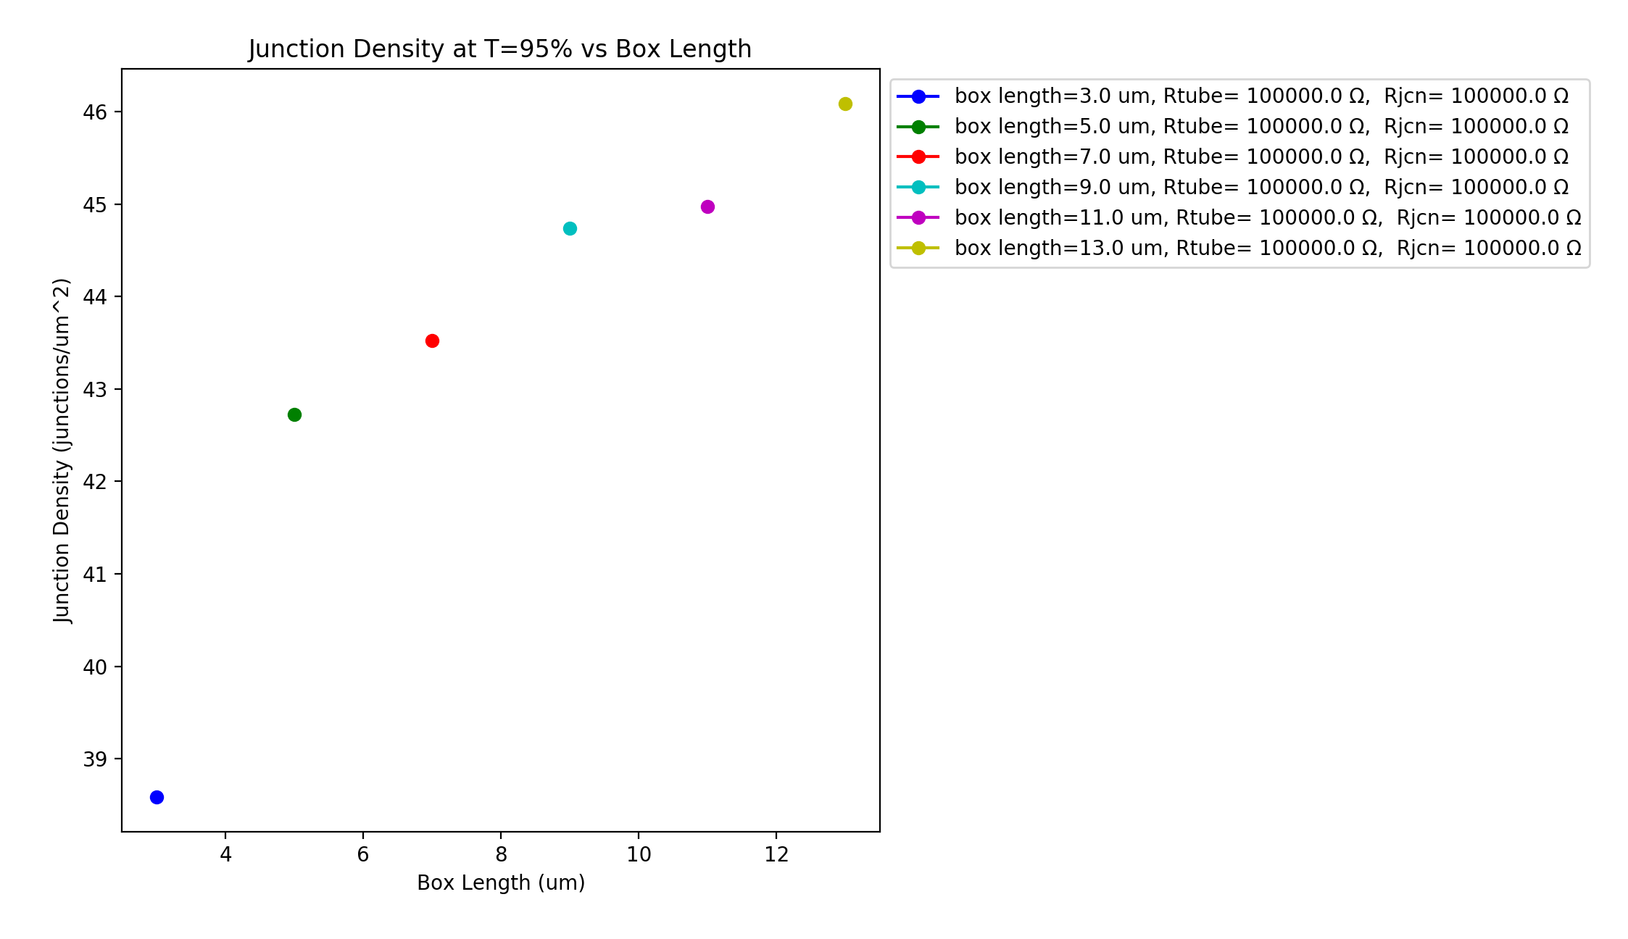
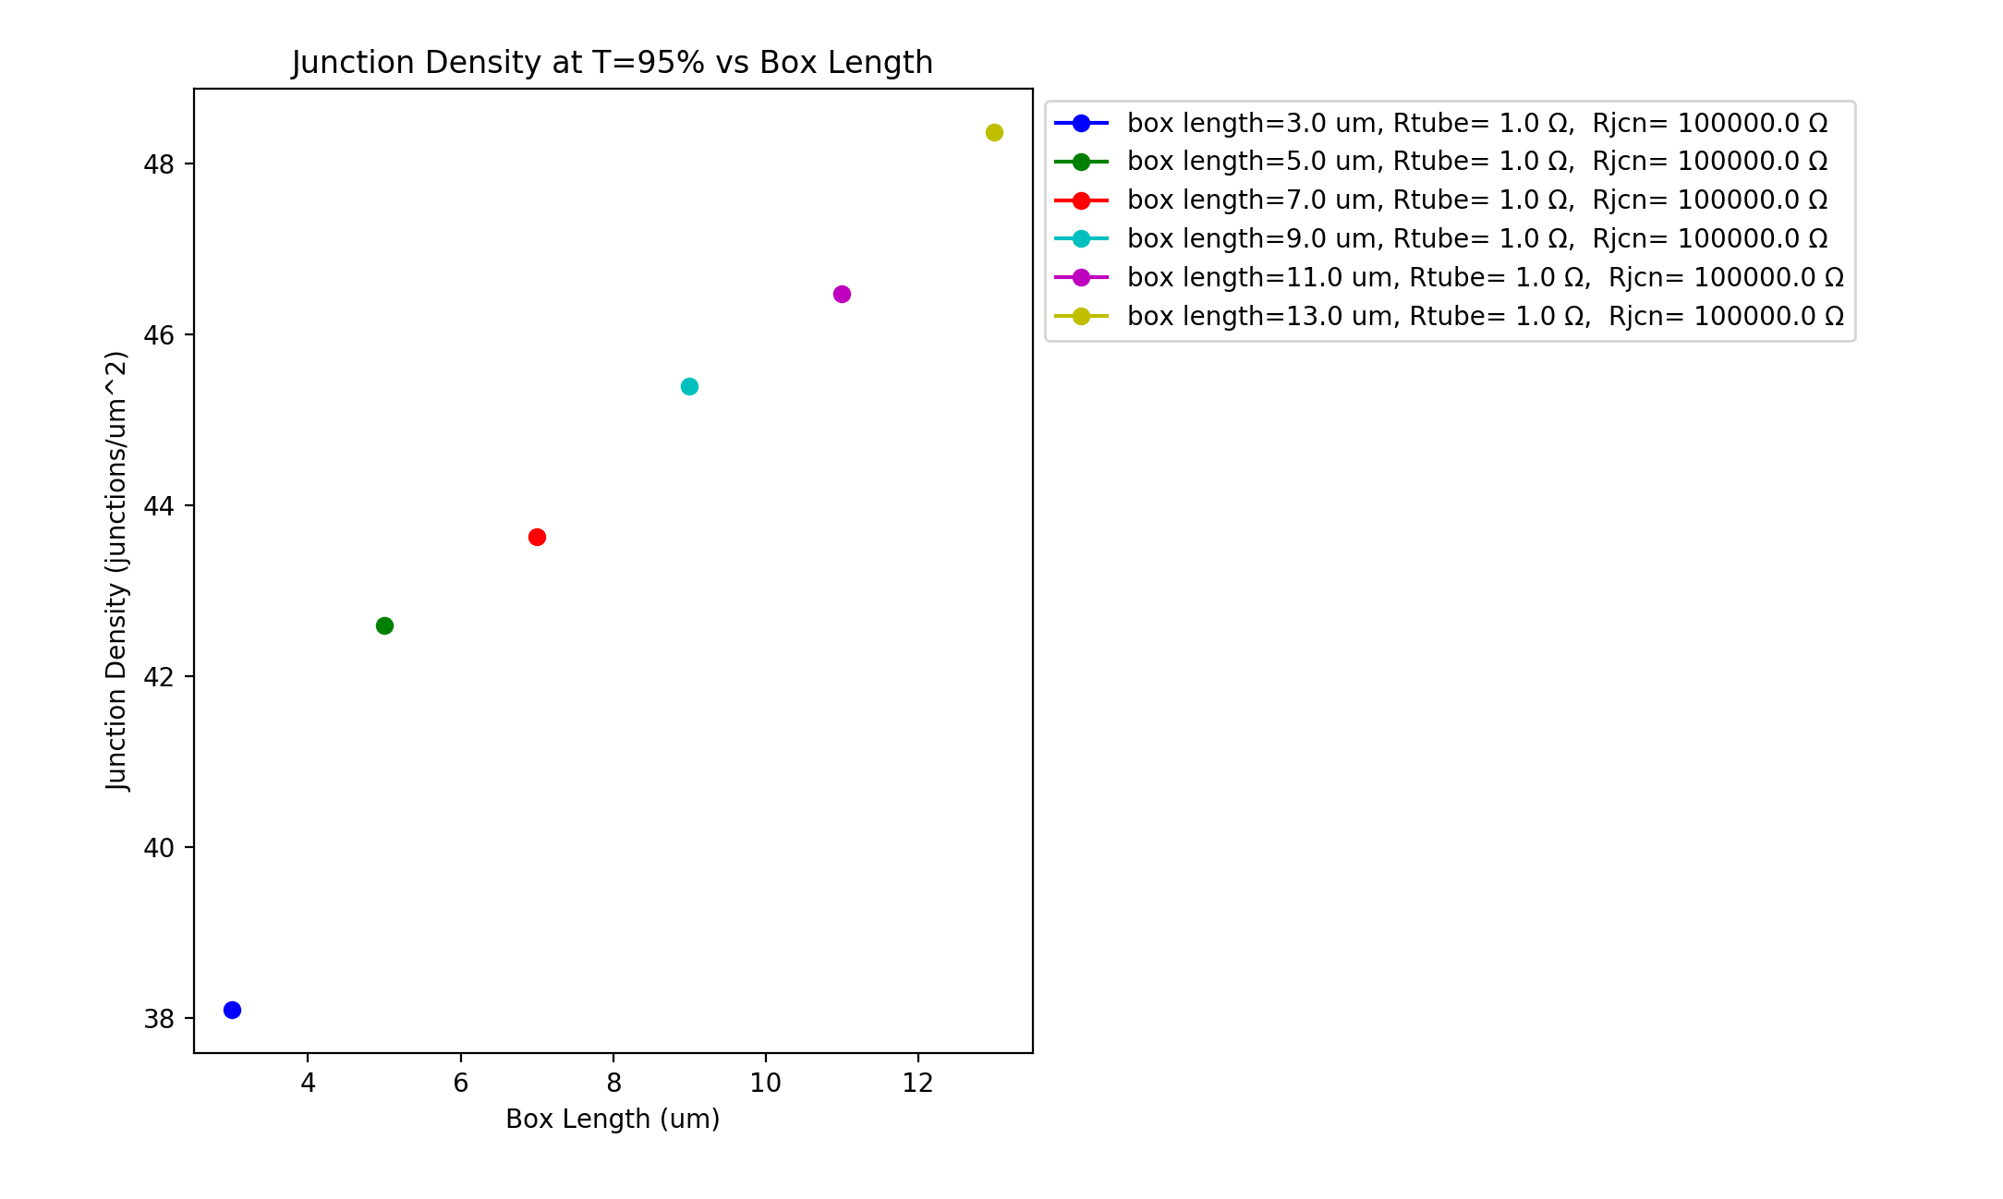
R_{jcn}=1Ω, R_{wire} $≅$100kΩ R_{jcn =}=100kΩ, R_{wire} $≅$100kΩ R_{jcn} =100kΩ, R_{wire} $≅$1Ω
Vary Box Length - 3 to 13 um (2um steps) - same Transmittance (95%)
Wire diameter: 1nm, Wire length: 1um, Samples: 15, 𝜌₀ constant, uniform wire length,
network density: 6.5644 to 19.6932 in 1.6411 wires/um² steps

Slide 8
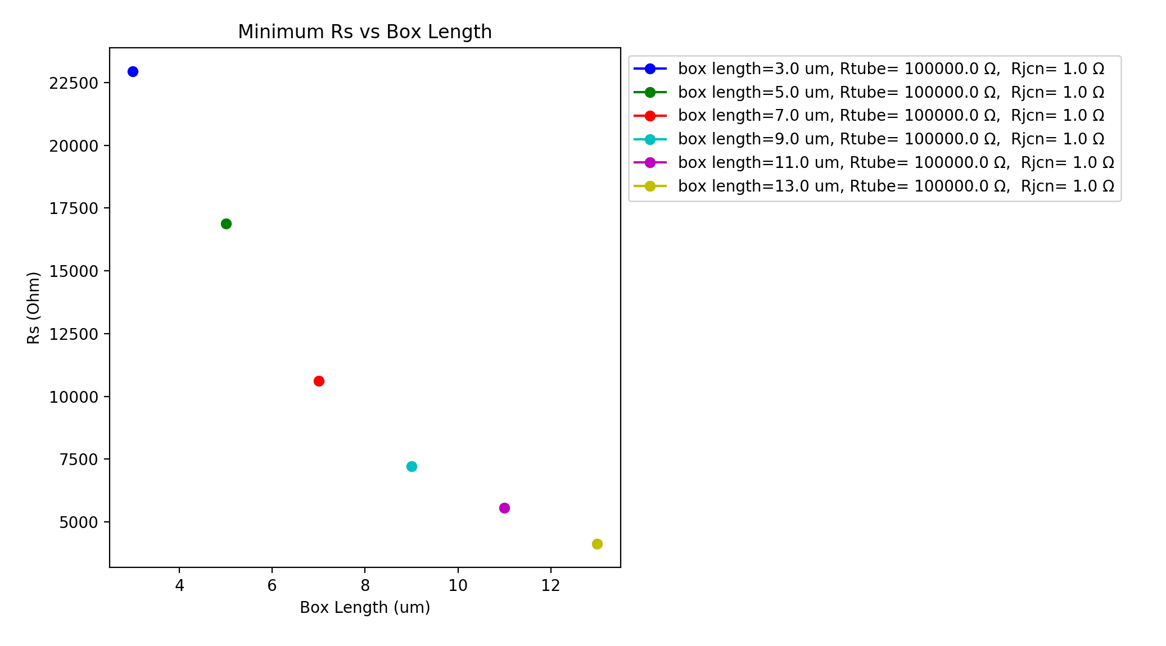
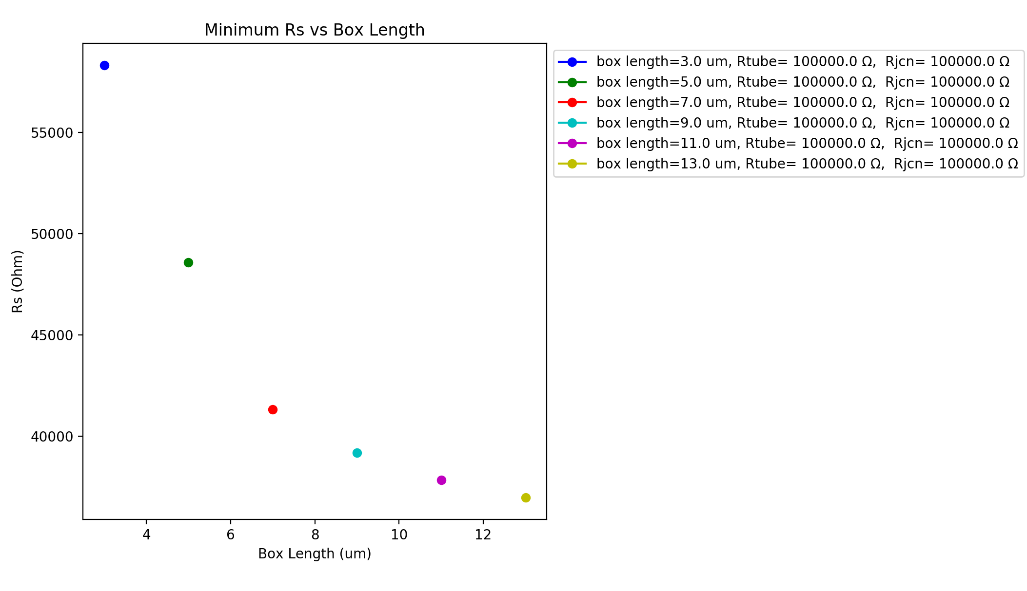
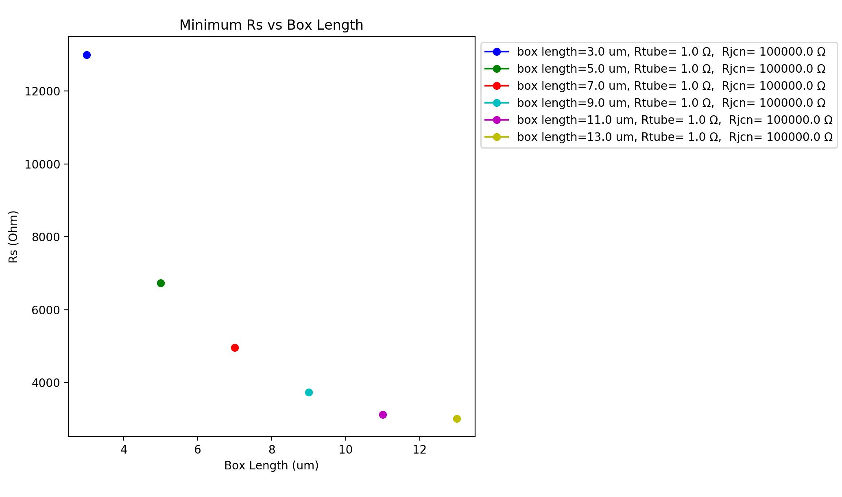
R_{jcn}=1Ω, R_{wire} $≅$100kΩ R_{jcn =}=100kΩ, R_{wire} $≅$100kΩ R_{jcn} =100kΩ, R_{wire} $≅$1Ω
Vary Box Length - 3 to 13 um (2um steps) - same network density
Wire diameter: 1nm, Wire length: 1um, Samples: 15, 𝜌₀ constant, uniform wire length,
network density: 6.5644 to 19.6932 in 1.6411 wires/um² steps

Slide 9
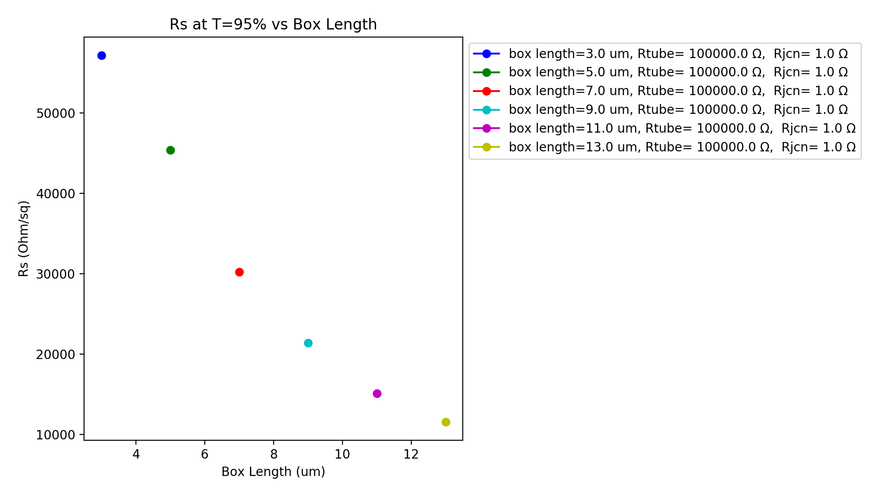
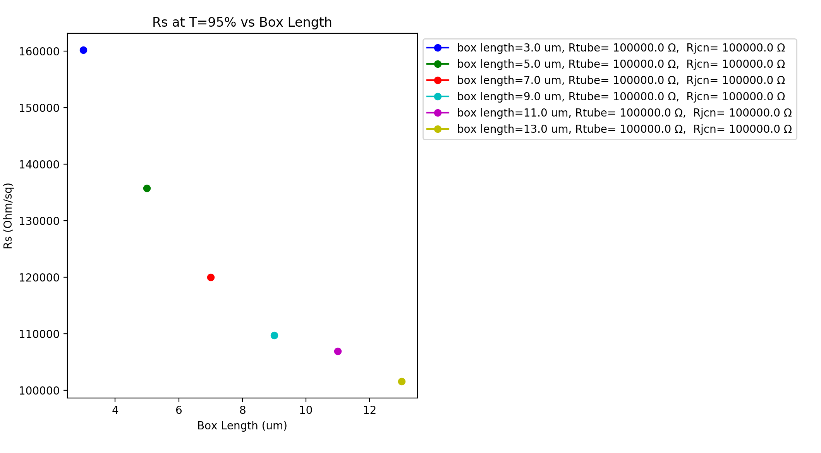
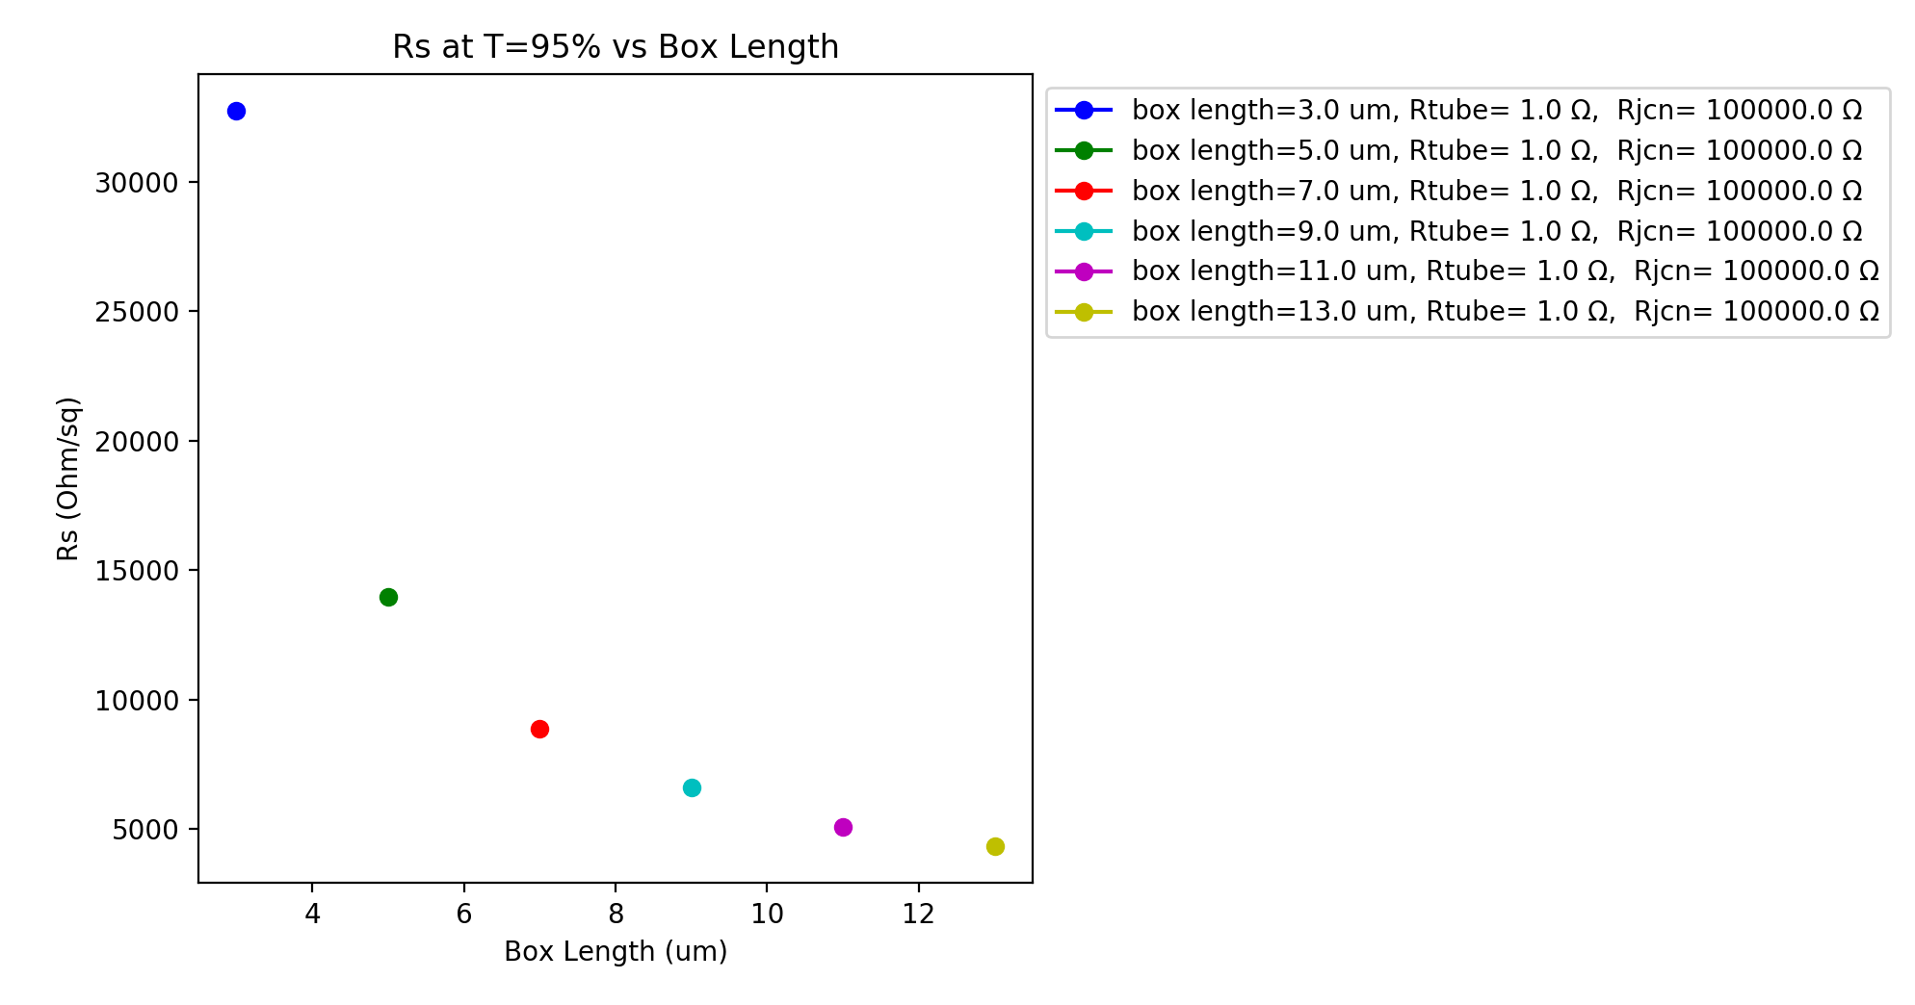
R_{jcn}=1Ω, R_{wire} $≅$100kΩ R_{jcn =}=100kΩ, R_{wire} $≅$100kΩ R_{jcn} =100kΩ, R_{wire} $≅$1Ω
Vary Box Length - 3 to 13 um (2um steps) - same Transmittance (95%)
Wire diameter: 1nm, Wire length: 1um, Samples: 15, 𝜌₀ constant, uniform wire length,
network density: 6.5644 to 19.6932 in 1.6411 wires/um² steps

Slide 10
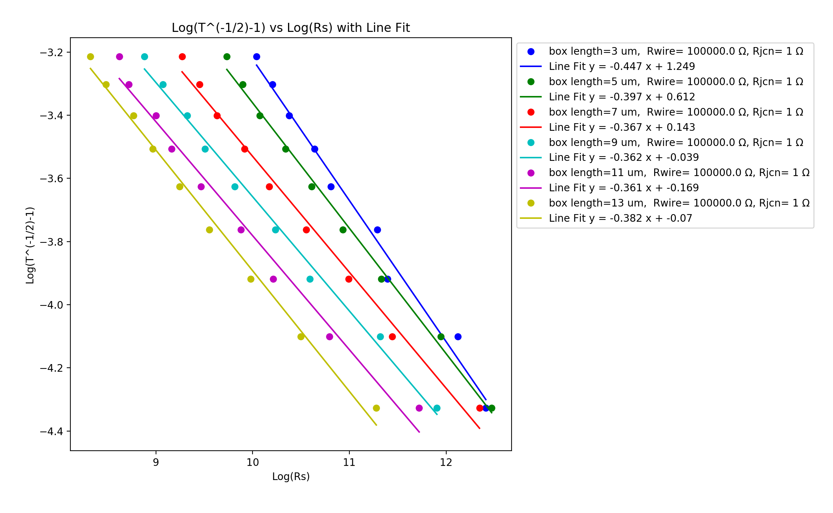
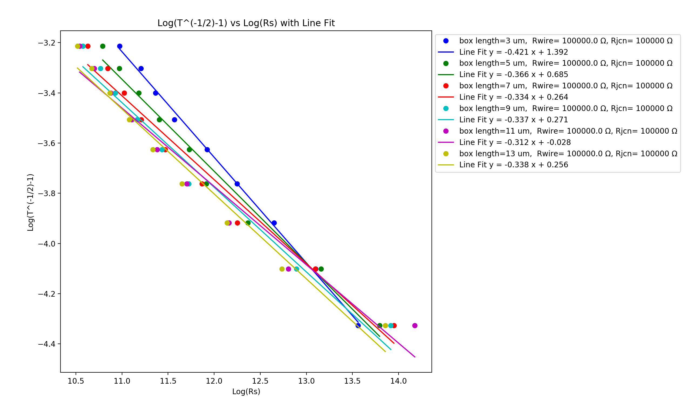
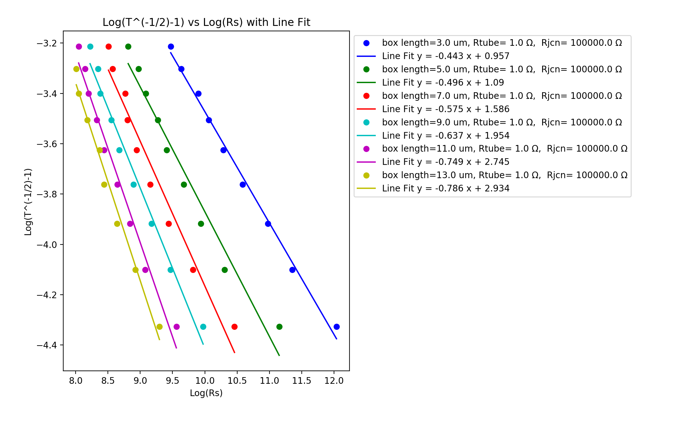
R_{jcn}=1Ω, R_{wire} $≅$100kΩ R_{jcn =}=100kΩ, R_{wire} $≅$100kΩ R_{jcn} =100kΩ, R_{wire} $≅$1Ω
Vary Box Length - 3 to 13 um (2um steps) - same Transmittance (95%)
Wire diameter: 1nm, Wire length: 1um, Samples: 15, 𝜌₀ constant, uniform wire length,
network density: 6.5644 to 19.6932 in 1.6411 wires/um² steps

Slide 11
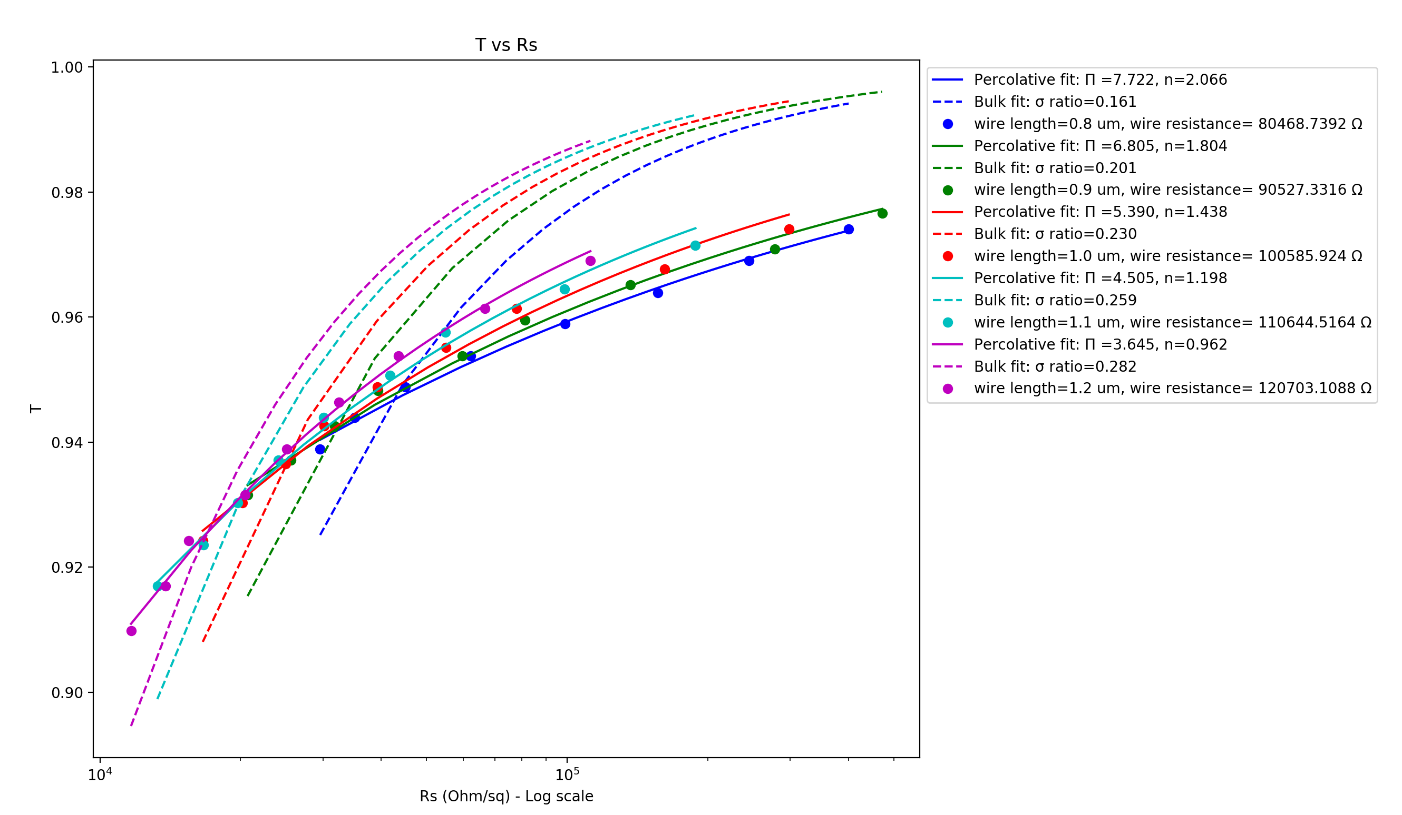
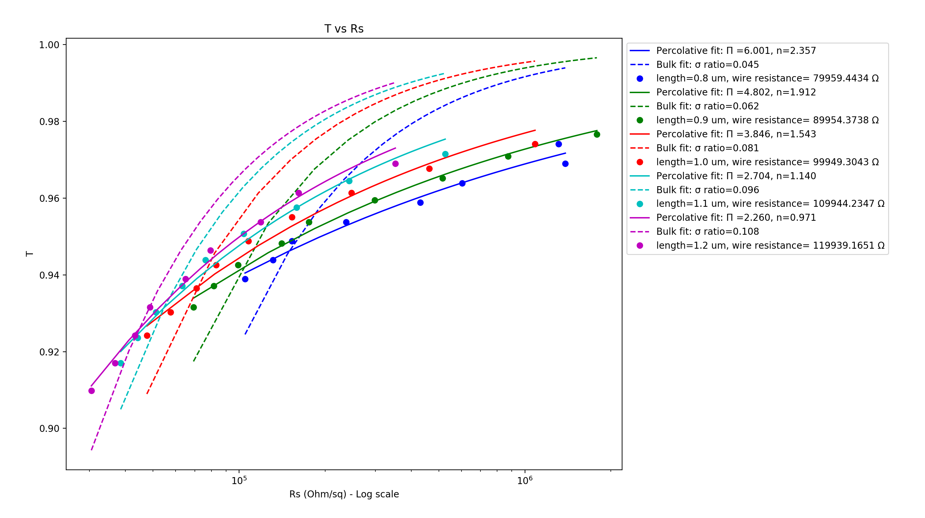
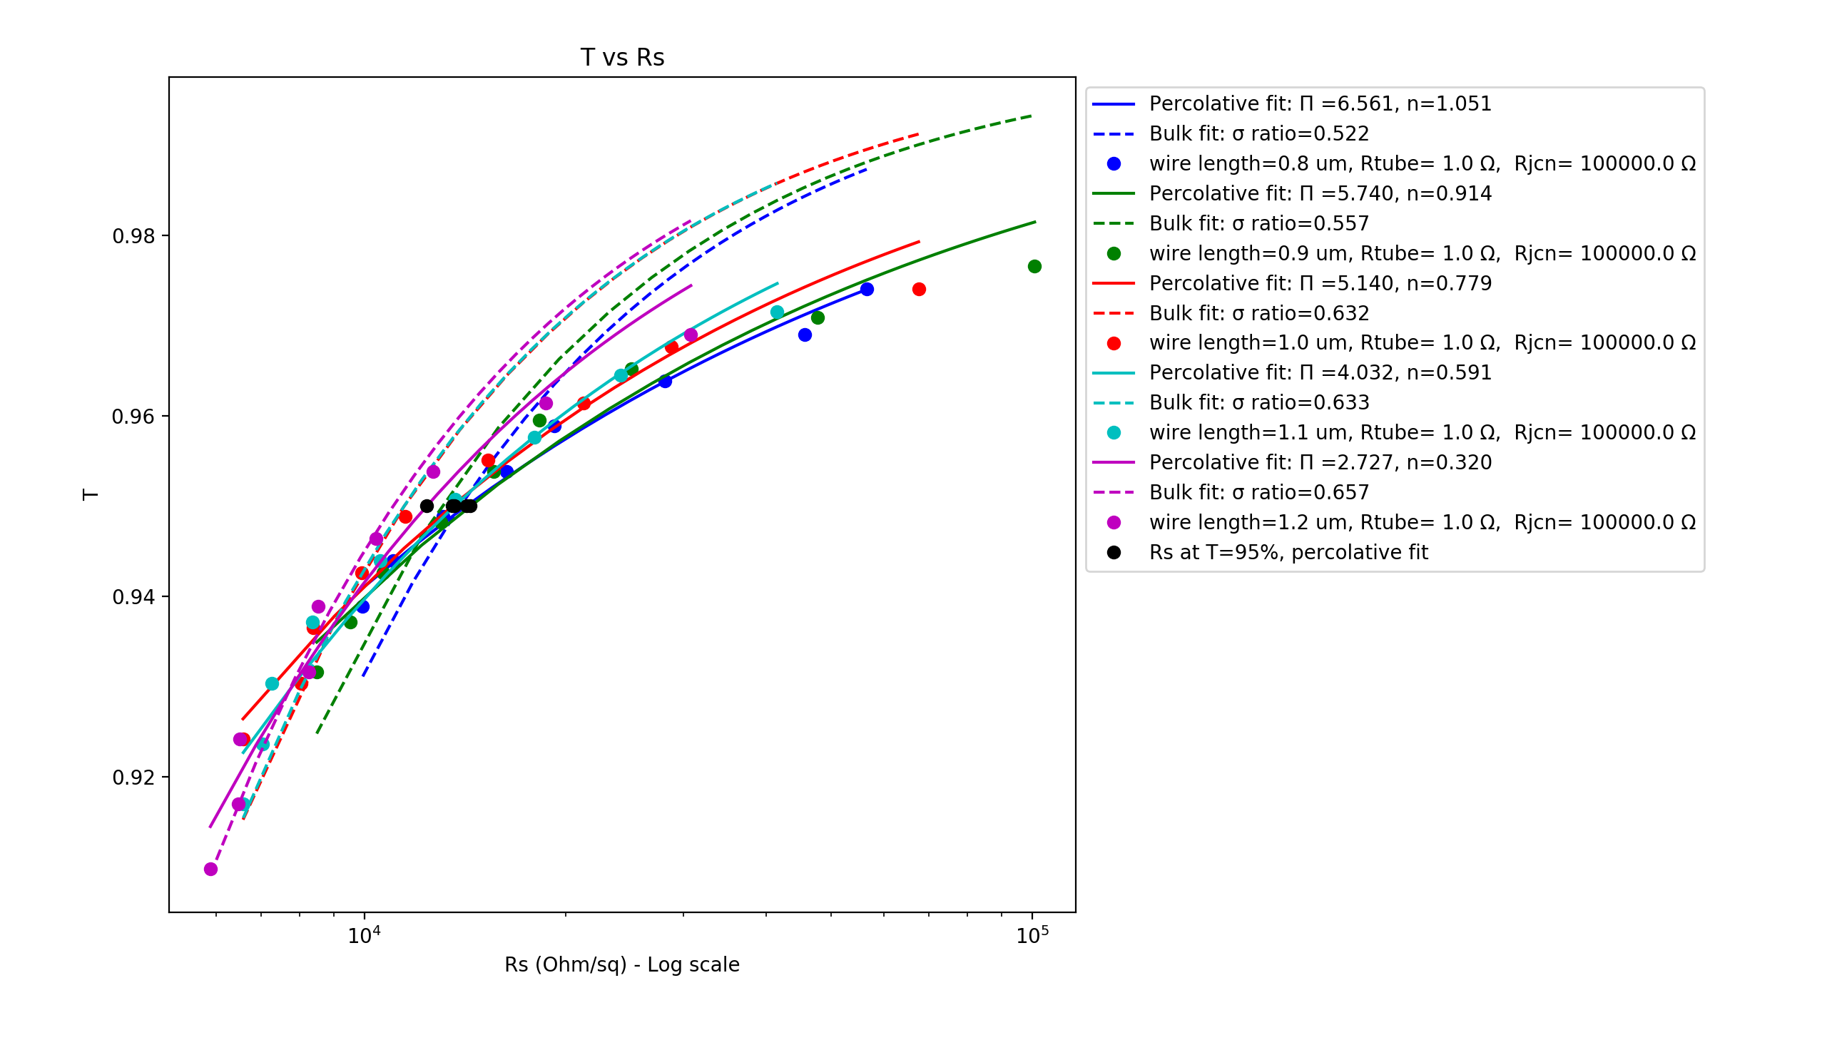
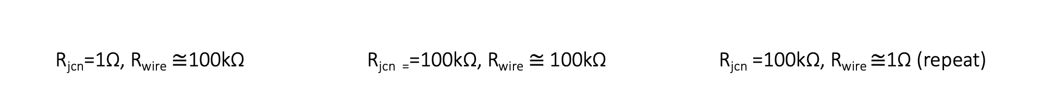
R_{jcn}=1Ω, R_{wire} $≅$100kΩ R_{jcn =}=100kΩ, R_{wire} $≅$100kΩ R_{jcn} =100kΩ, R_{wire} $≅$1Ω (repeat)
Vary Wire Length – 0.8-1.2 um (0.1um steps)
Wire diameter: 1nm, Box length: 5um, Samples: 15, uniform wire length,
network density: 6.5644 to 19.6932 in 1.6411 wires/um² steps

Slide 12
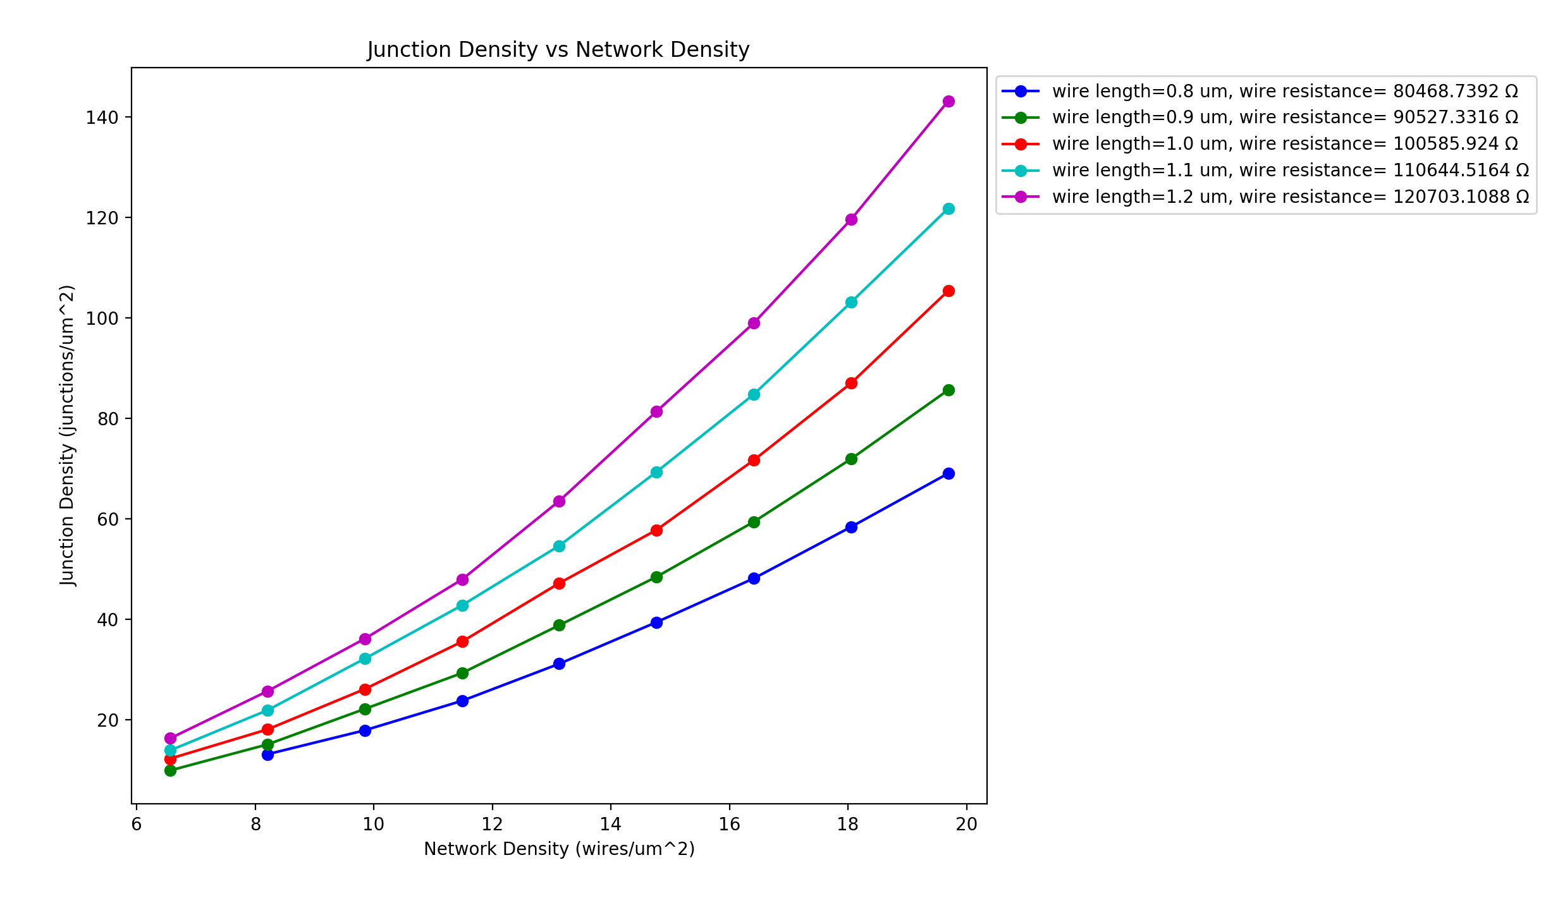
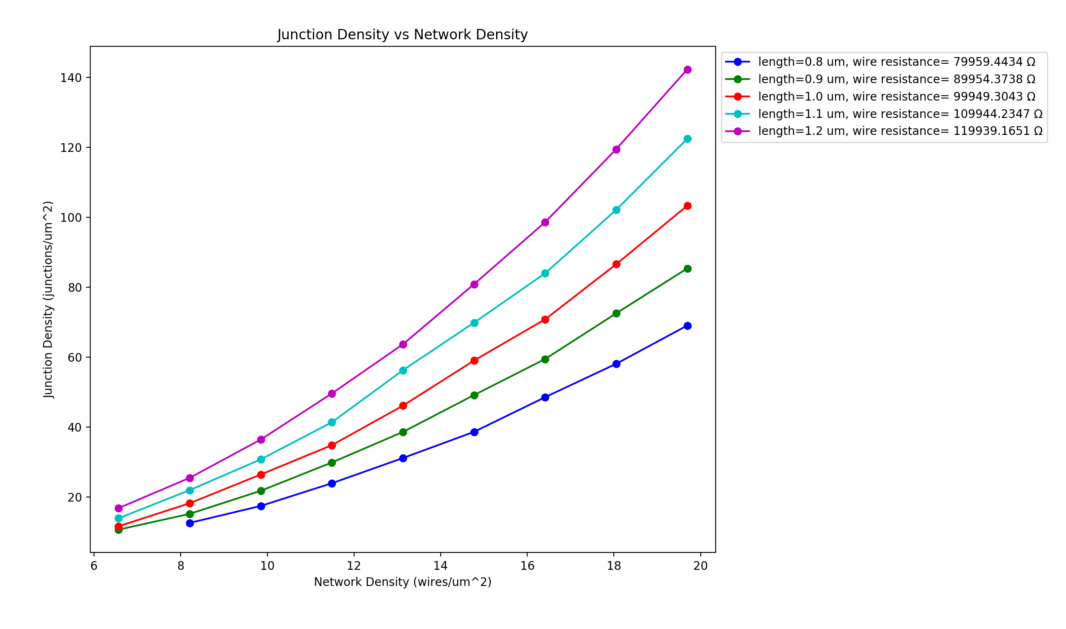
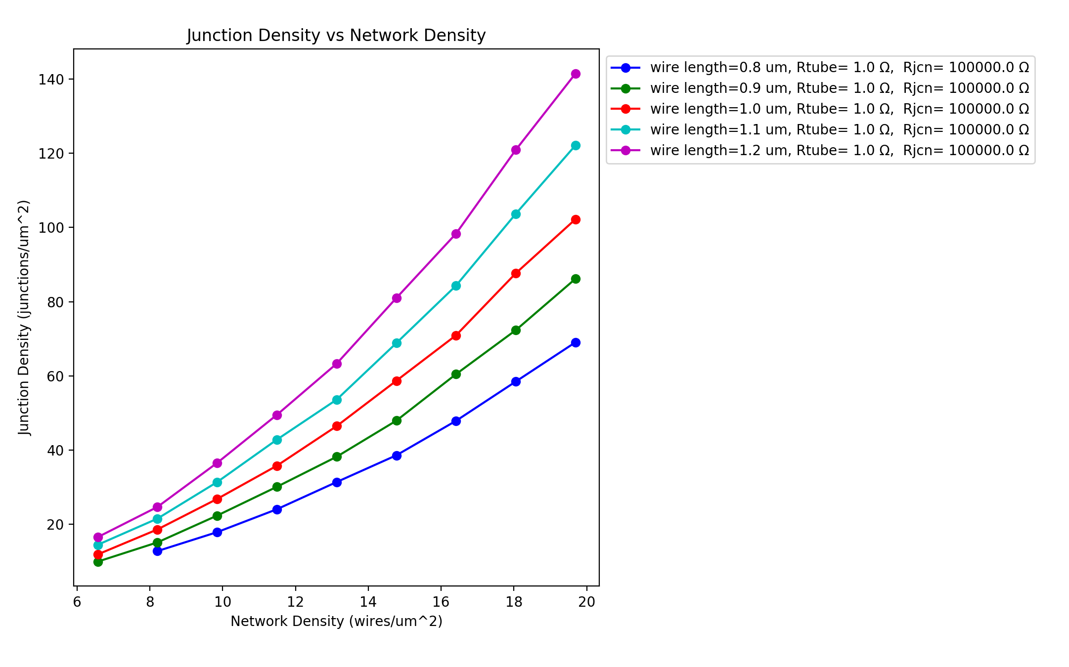
R_{jcn}=1Ω, R_{wire} $≅$100kΩ R_{jcn =}=100kΩ, R_{wire} $≅$100kΩ R_{jcn} =100kΩ, R_{wire} $≅$1Ω (repeat)
Vary Wire Length – 0.8-1.2 um (0.1um steps)
Wire diameter: 1nm, Box length: 5um, Samples: 15, uniform wire length,
network density: 6.5644 to 19.6932 in 1.6411 wires/um² steps

Slide 13
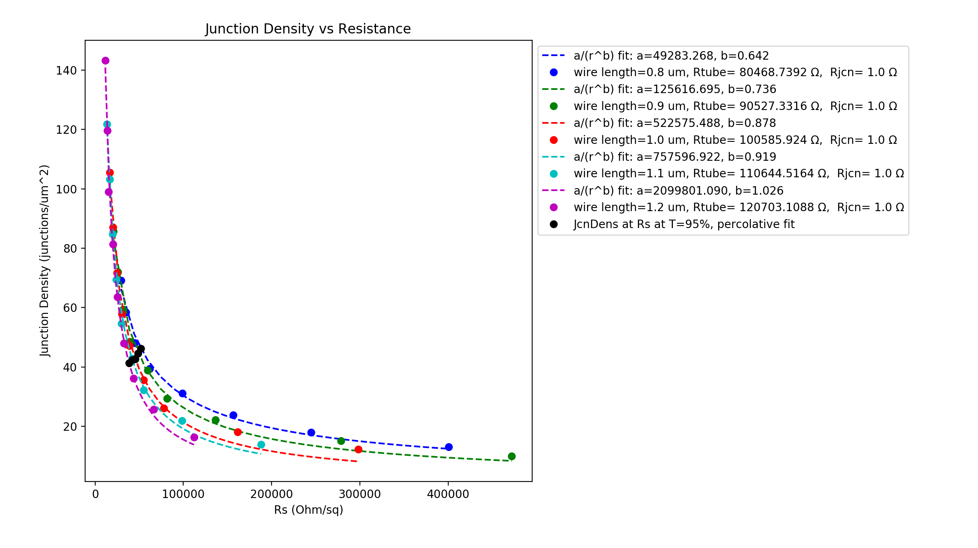
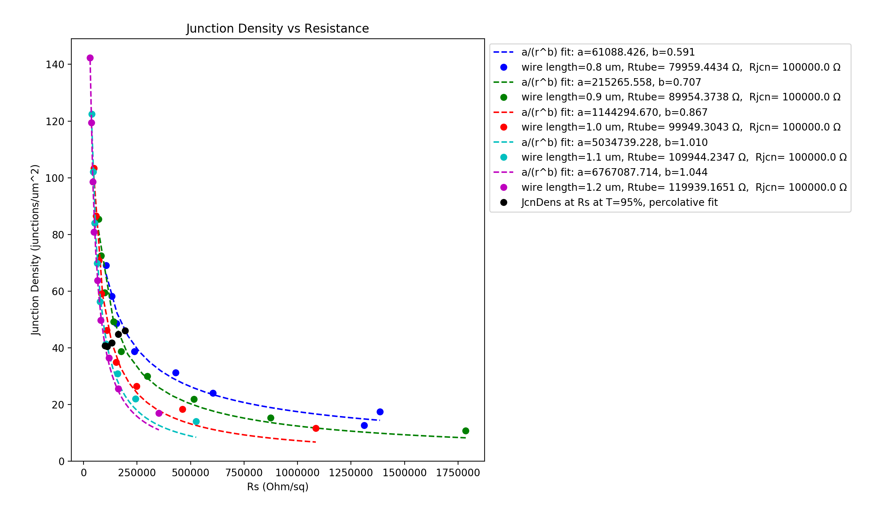
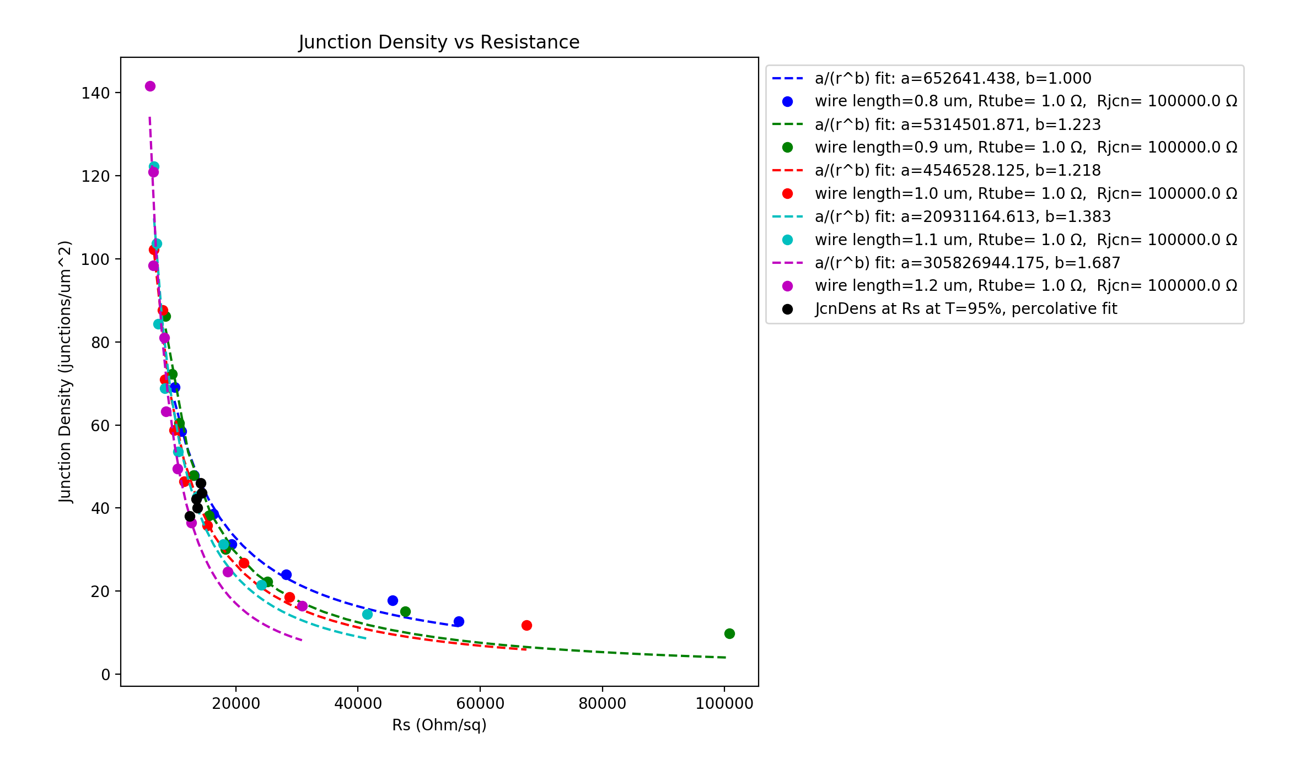
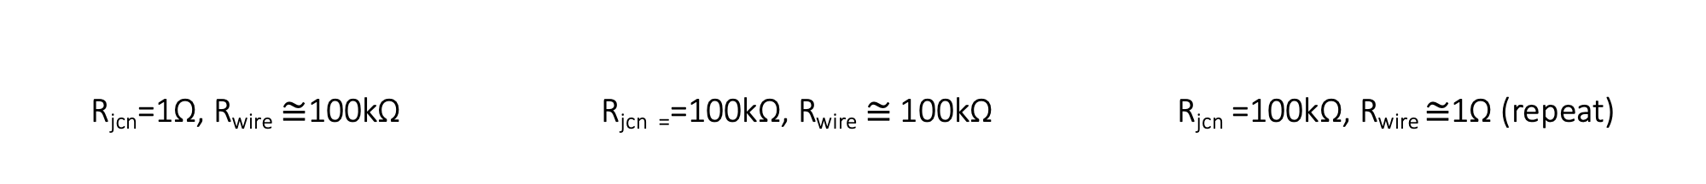
R_{jcn}=1Ω, R_{wire} $≅$100kΩ R_{jcn =}=100kΩ, R_{wire} $≅$100kΩ R_{jcn} =100kΩ, R_{wire} $≅$1Ω (repeat)
Vary Wire Length – 0.8-1.2 um (0.1um steps)
Wire diameter: 1nm, Box length: 5um, Samples: 15, uniform wire length,
network density: 6.5644 to 19.6932 in 1.6411 wires/um² steps

Slide 14
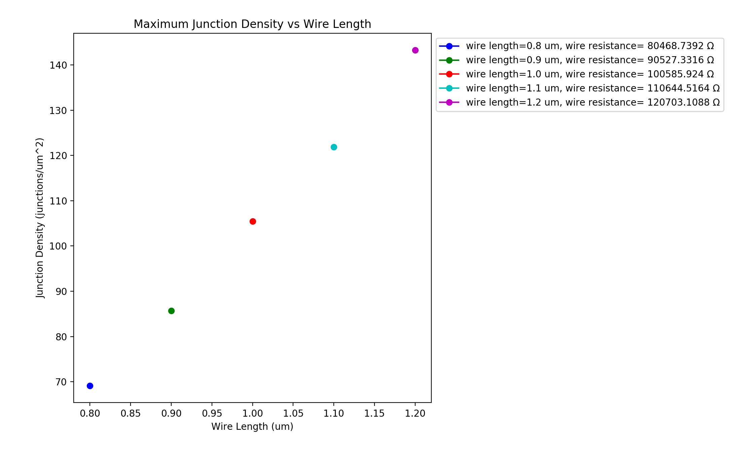
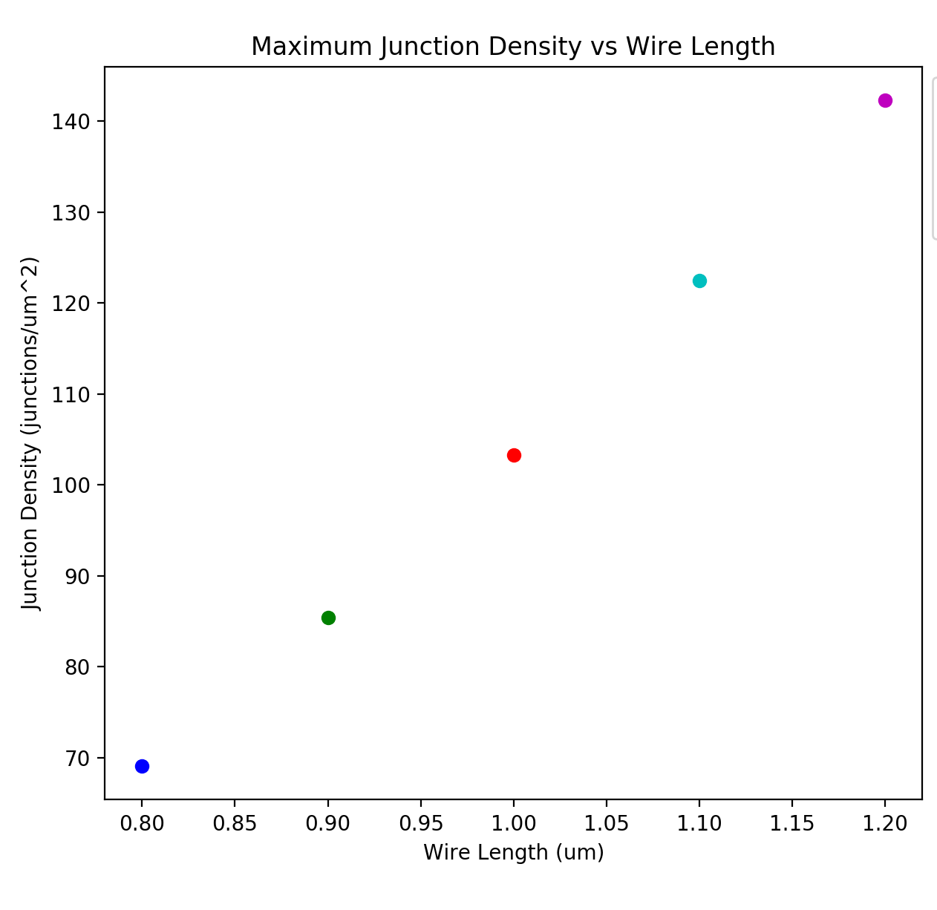
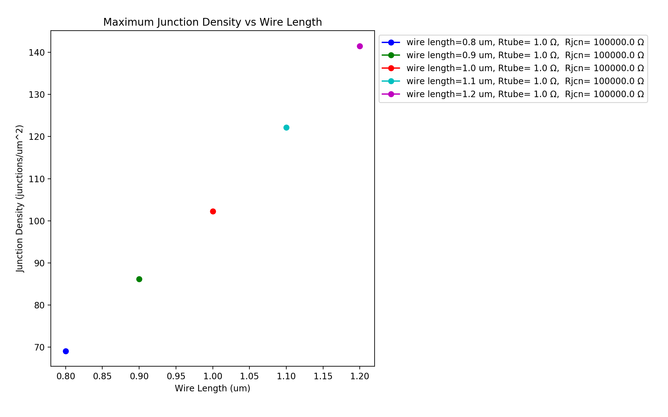
R_{jcn}=1Ω, R_{wire} $≅$100kΩ R_{jcn =}=100kΩ, R_{wire} $≅$100kΩ R_{jcn} =100kΩ, R_{wire} $≅$1Ω (repeat)
Vary Wire Length – 0.8-1.2 um (0.1um steps) – same network density
Wire diameter: 1nm, Box length: 5um, Samples: 15, uniform wire length,
network density: 6.5644 to 19.6932 in 1.6411 wires/um² steps

Slide 15
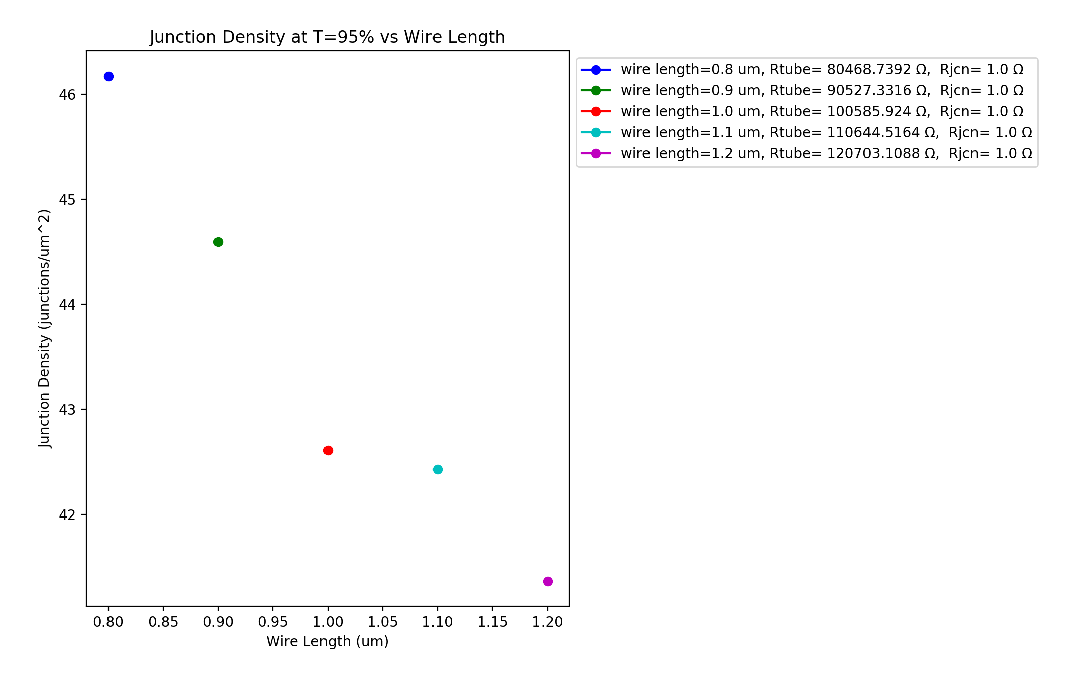
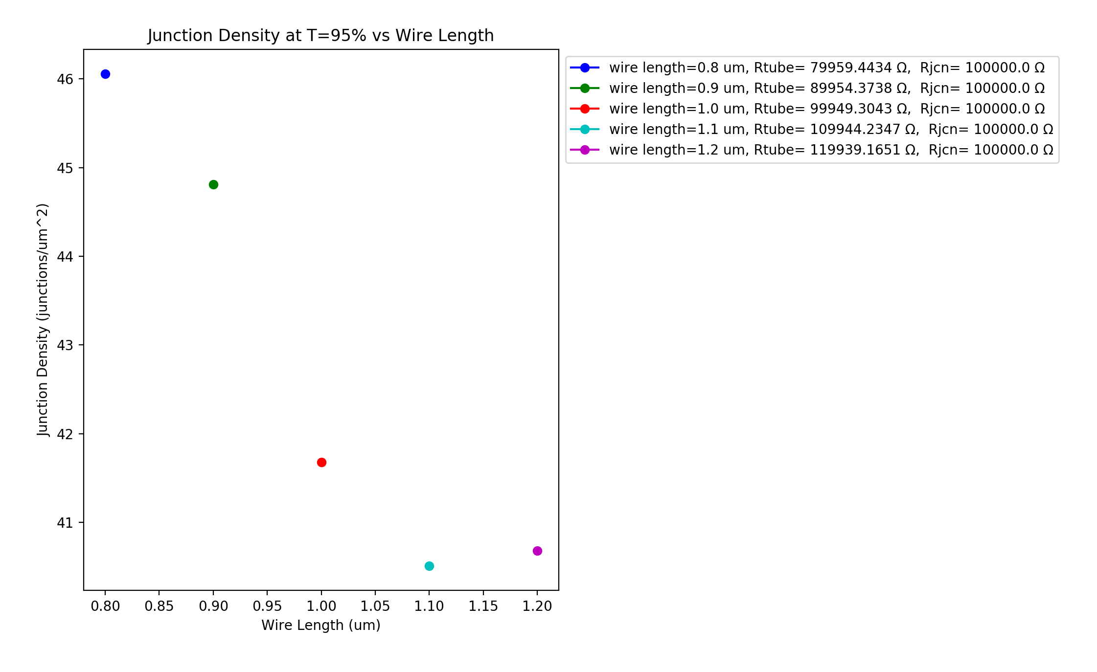
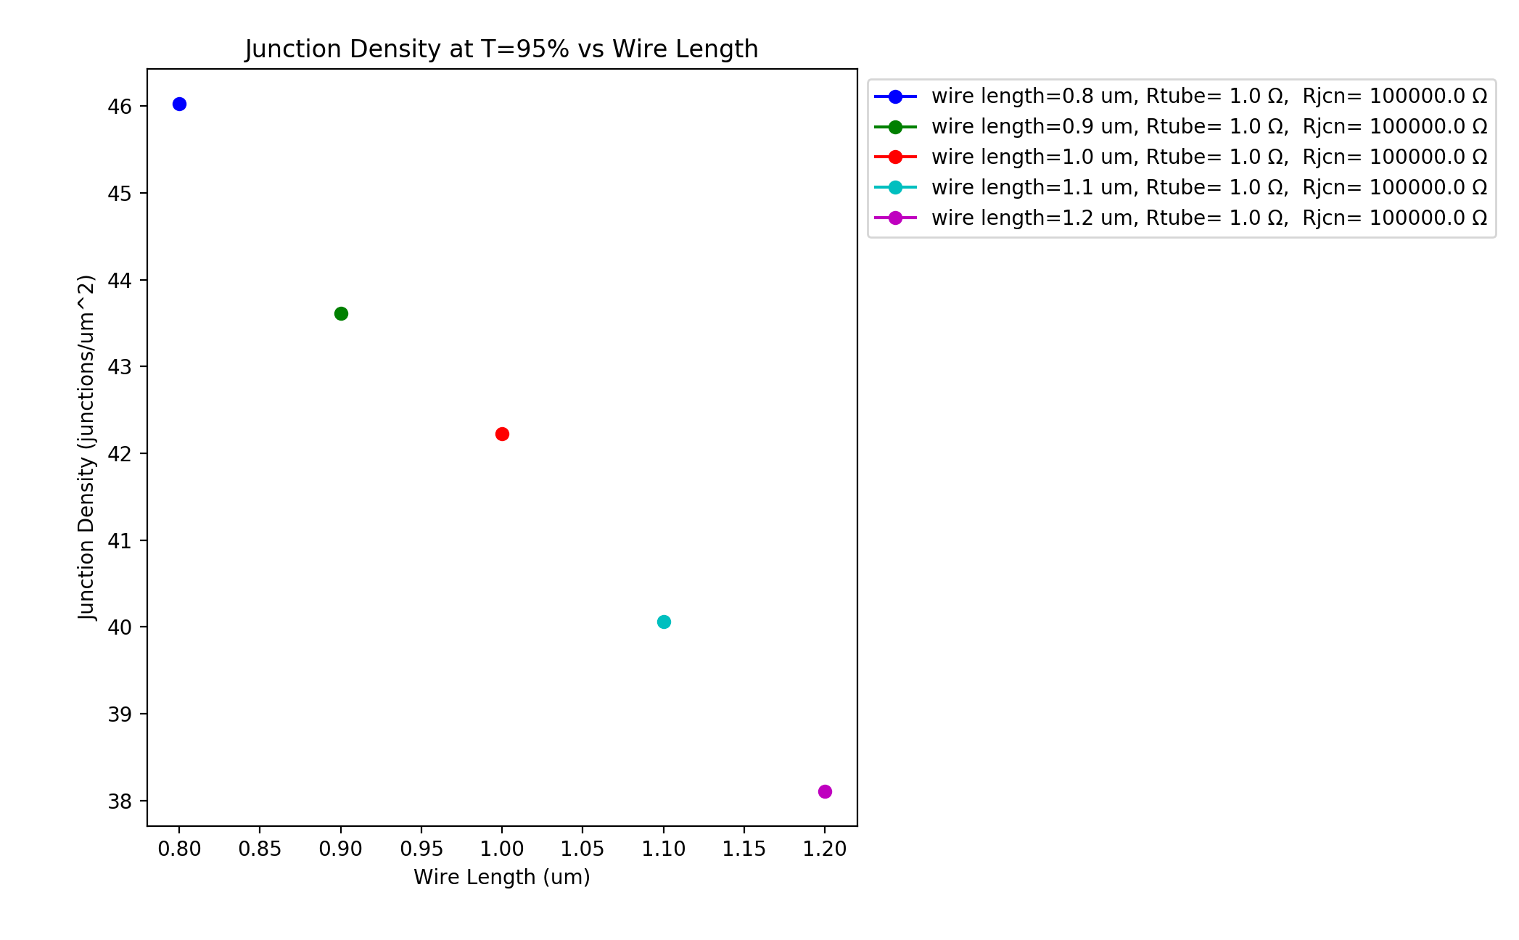
R_{jcn}=1Ω, R_{wire} $≅$100kΩ R_{jcn =}=100kΩ, R_{wire} $≅$100kΩ R_{jcn} =100kΩ, R_{wire} $≅$1Ω (repeat)
Vary Wire Length – 0.8-1.2 um (0.1um steps) – same Transmittance (95%)
Wire diameter: 1nm, Box length: 5um, Samples: 15, uniform wire length,
network density: 6.5644 to 19.6932 in 1.6411 wires/um² steps

Slide 16
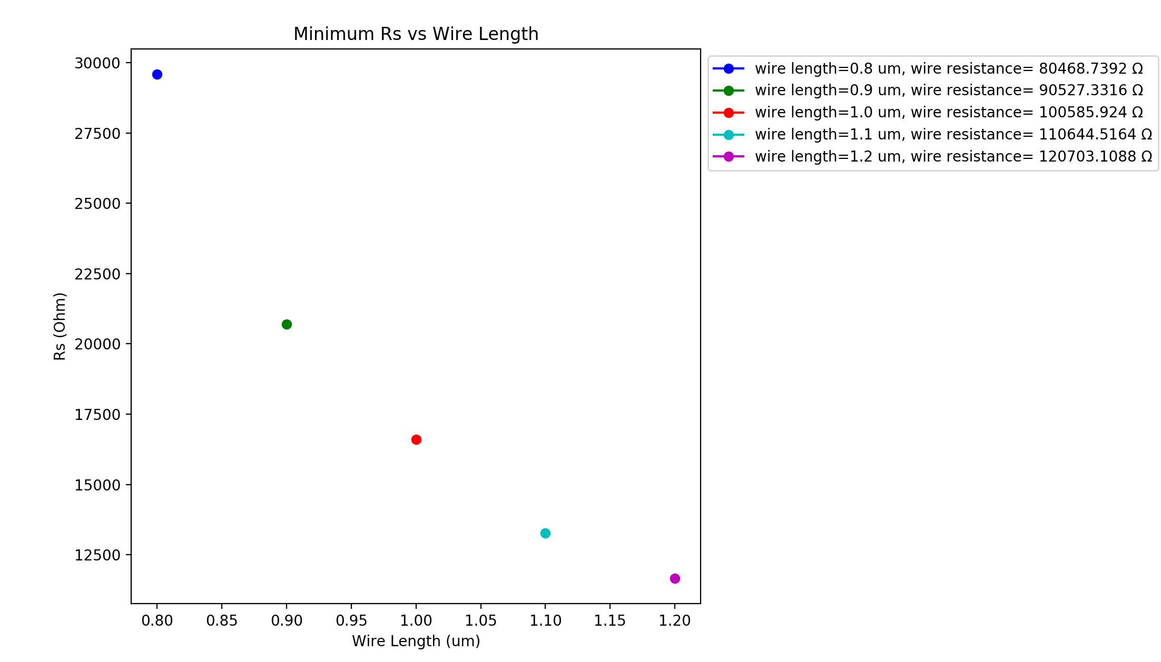
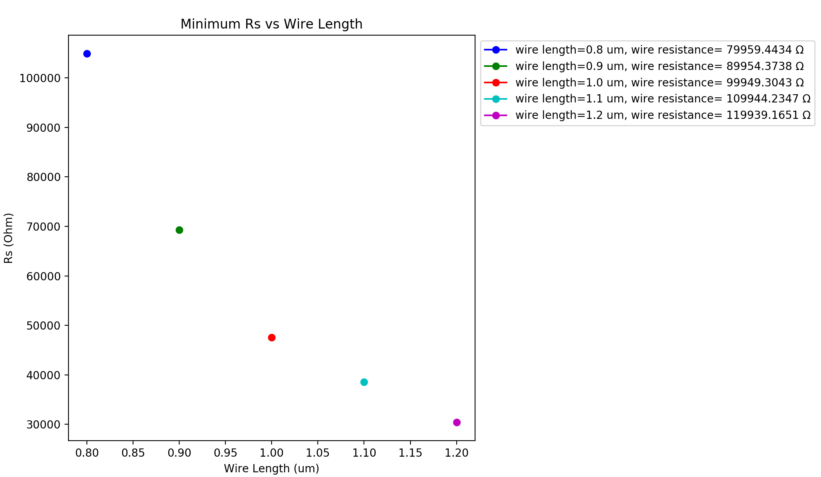
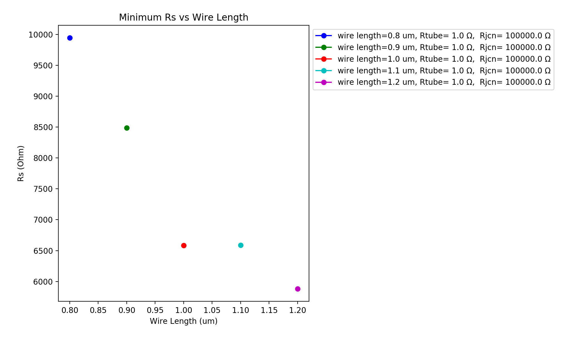
R_{jcn}=1Ω, R_{wire} $≅$100kΩ R_{jcn =}=100kΩ, R_{wire} $≅$100kΩ R_{jcn} =100kΩ, R_{wire} $≅$1Ω (repeat)
Vary Wire Length – 0.8-1.2 um (0.1um steps) –same network density
Wire diameter: 1nm, Box length: 5um, Samples: 15, uniform wire length,
network density: 6.5644 to 19.6932 in 1.6411 wires/um² steps

Slide 17
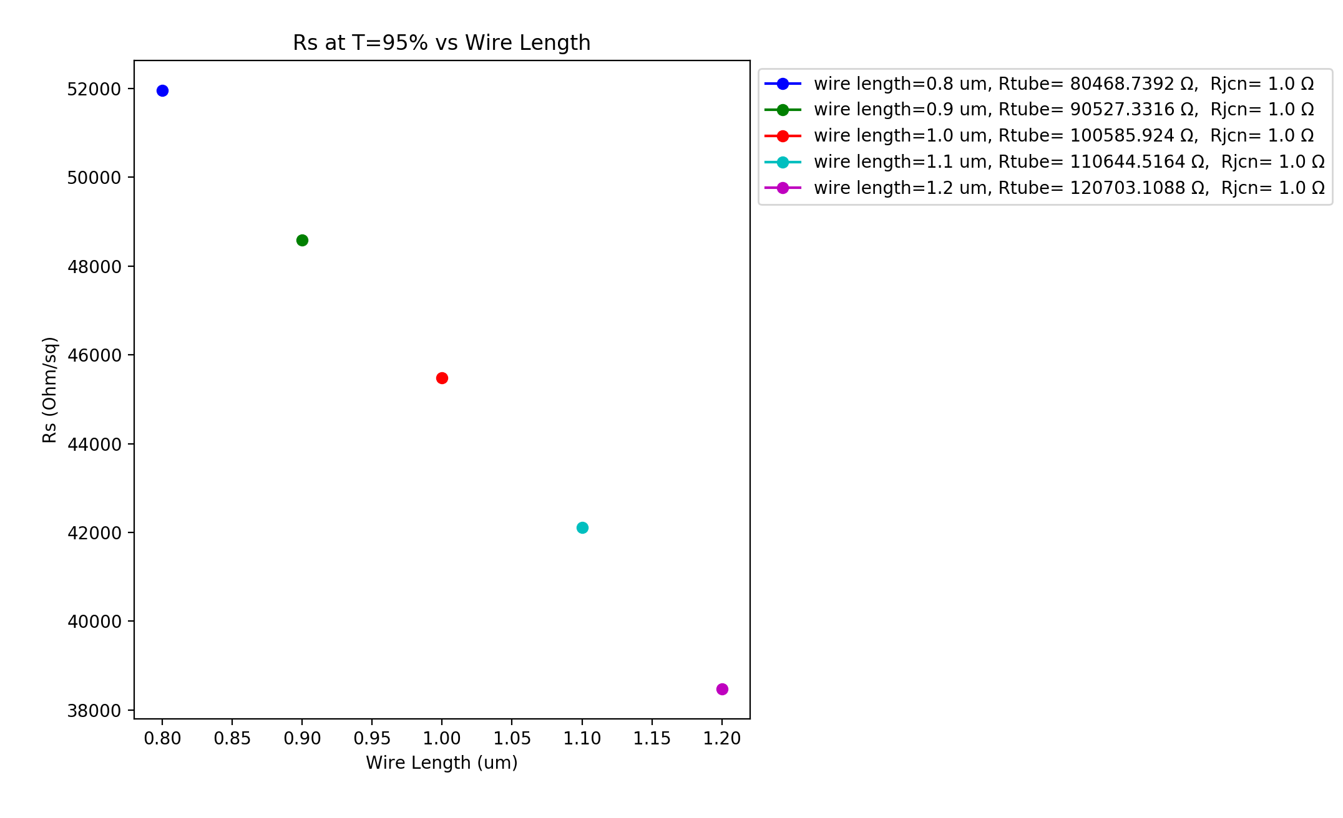


R_{jcn}=1Ω, R_{wire} $≅$100kΩ R_{jcn =}=100kΩ, R_{wire} $≅$100kΩ R_{jcn} =100kΩ, R_{wire} $≅$1Ω (repeat)
Vary Wire Length – 0.8-1.2 um (0.1um steps) – same Transmittance (95%)
Wire diameter: 1nm, Box length: 5um, Samples: 15, uniform wire length,
network density: 6.5644 to 19.6932 in 1.6411 wires/um² steps

Slide 18



R_{jcn}=1Ω, R_{wire} $≅$100kΩ R_{jcn =}=100kΩ, R_{wire} $≅$100kΩ R_{jcn} =100kΩ, R_{wire} $≅$1Ω (repeat)
Vary Wire Length – 0.8-1.2 um (0.1um steps)
Wire diameter: 1nm, Box length: 5um, Samples: 15, uniform wire length,
network density: 6.5644 to 19.6932 in 1.6411 wires/um² steps

Slide 19


R_{jcn} =100kΩ, R_{wire}=1Ω
Vary Wire Length – 0.8-1.2 um (0.1um steps) – constant AF
Box size: 5um Box size: 10 um
Wire diameter: 1nm, Samples: 15, uniform wire length,
network density: 6.5644 to 19.6932 in 1.6411 wires/um² steps

Slide 20


R_{jcn} =100kΩ, R_{wire}=1Ω
Vary Wire Length – 0.8-1.2 um (0.1um steps) – constant AF
Box size: 5um Box size: 10 um
Wire diameter: 1nm, Samples: 15, uniform wire length,
network density: 6.5644 to 19.6932 in 1.6411 wires/um² steps

Slide 21


R_{jcn} =100kΩ, R_{wire}=1Ω
Vary Wire Length – 0.8-1.2 um (0.1um steps) – constant AF
Box size: 5um Box size: 10 um
Wire diameter: 1nm, Samples: 15, uniform wire length,
network density: 6.5644 to 19.6932 in 1.6411 wires/um² steps

